Slide 1
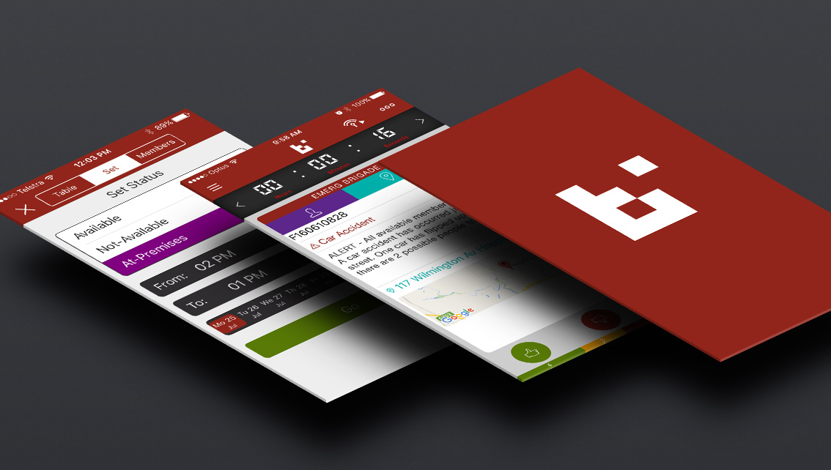
BART App Walkthrough
For new BART users

Slide 2
Our Group has decided to use BART: Broadcast. Alert. Respond. Turnout. as our preferred response management system
Why BART?
BART…
is a cost effective way of using available technology to communicate with each other for CFS purposes
has GPS tracking capabilities so we can see people and vehicles on an electronic map when we respond to an incident

Slide 3
How will BART affect you?
We would like everyone with a smartphone to install the BART app so we can see when you are responding to an incident
This is not compulsory however strongly encouraged
Why do we need to know you are responding?
So we can see if your brigade has enough crew to respond an appliance to an incident
If you can’t get a crew then the Group Duty Officer (GDO) can respond another brigade

Slide 4
What happens if I don’t have a smartphone or I don’t want to use BART?
You are still a valued member of the brigade; The management team just won’t be aware that you are available to respond.
Non-smartphone users are able to receive alerts and messages via pre-paid SMS. They can also respond with their status: 0 - not coming 1 - coming 2 - other

Slide 5
How does BART work?
BART has 3 different platforms
Smartphone app for Android, iPhone and Windows Phone 8.1 & 10
Tablet app for Android & iPad
Two websites:
Dashboard
Regional platform
Let’s look at the BART smartphone app…

Slide 6
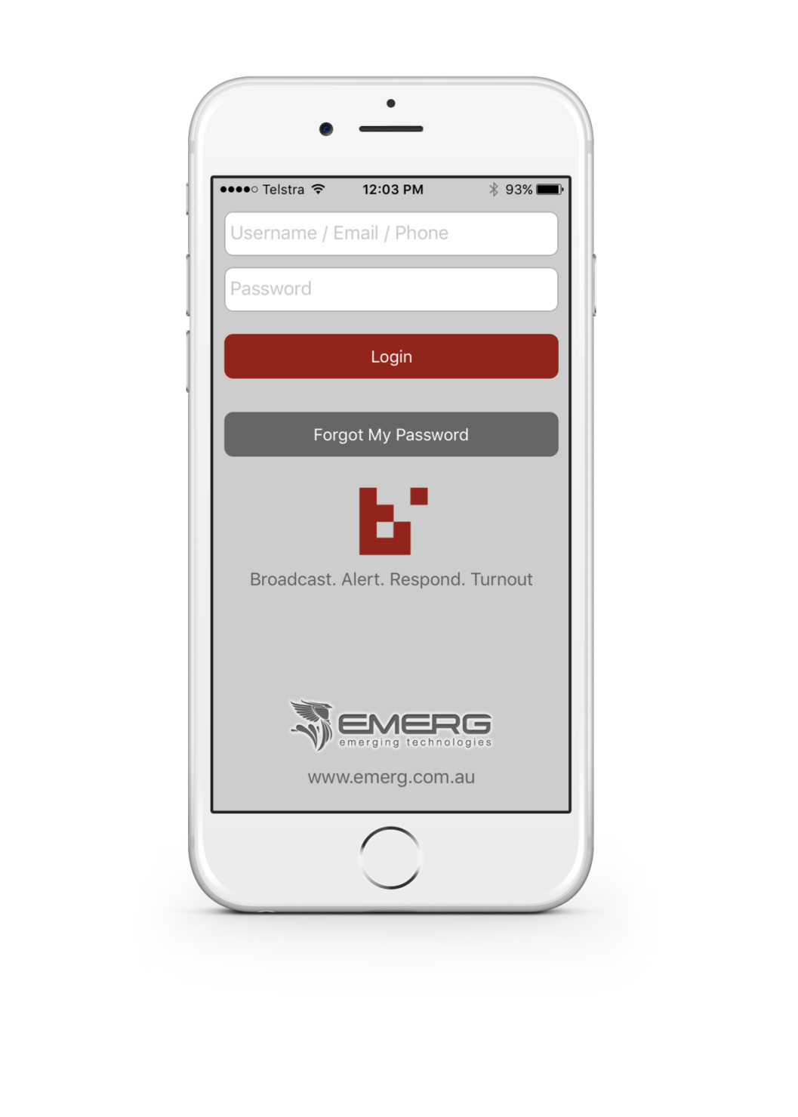
Smartphone Application
Your username and password will be supplied by your brigade BART Admin Coordinators

Slide 7
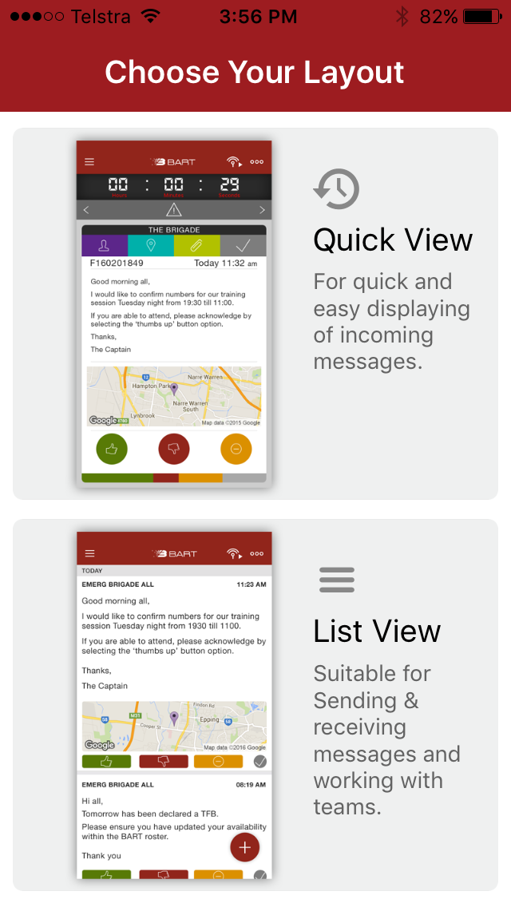
Choose your preferred layout:
Quick View
List View
Smartphone Application

Slide 8
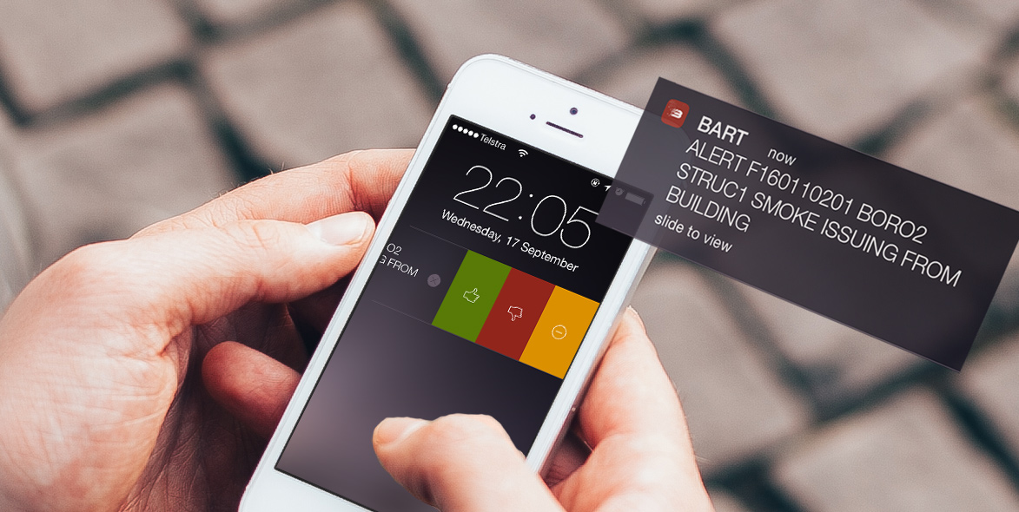
You can slide the Push Notification from your lock screen to respond directly to the alert or message
Respond from Push Notification

Slide 9
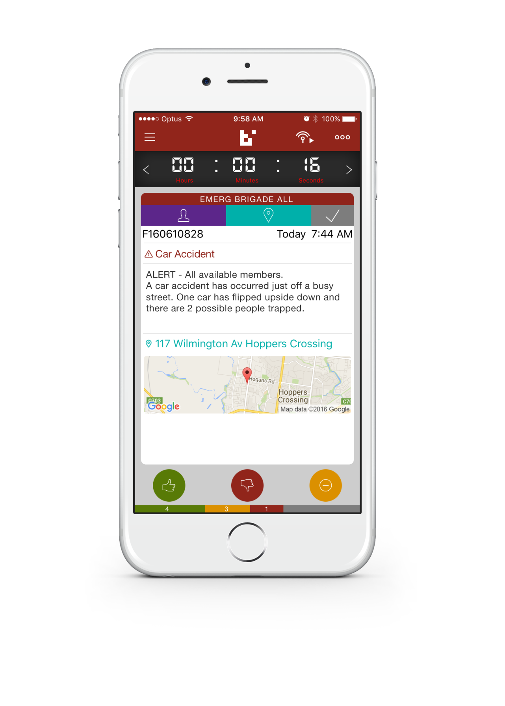
Quick View Screen
Scroll message right
Scroll message left
View Map
Mark as Completed Done by appointed brigade reps as set by BART administrator (Shows other brigade members the vehicles are back at station)
Who’s attending
If the Group Duty Officer responds they will hit the thumbs up
Tap thumbs down: NOT attending
Other: used by Group Duty Officer to acknowledge page (trialling)
Tap thumbs up: YOU ARE attending

Slide 10
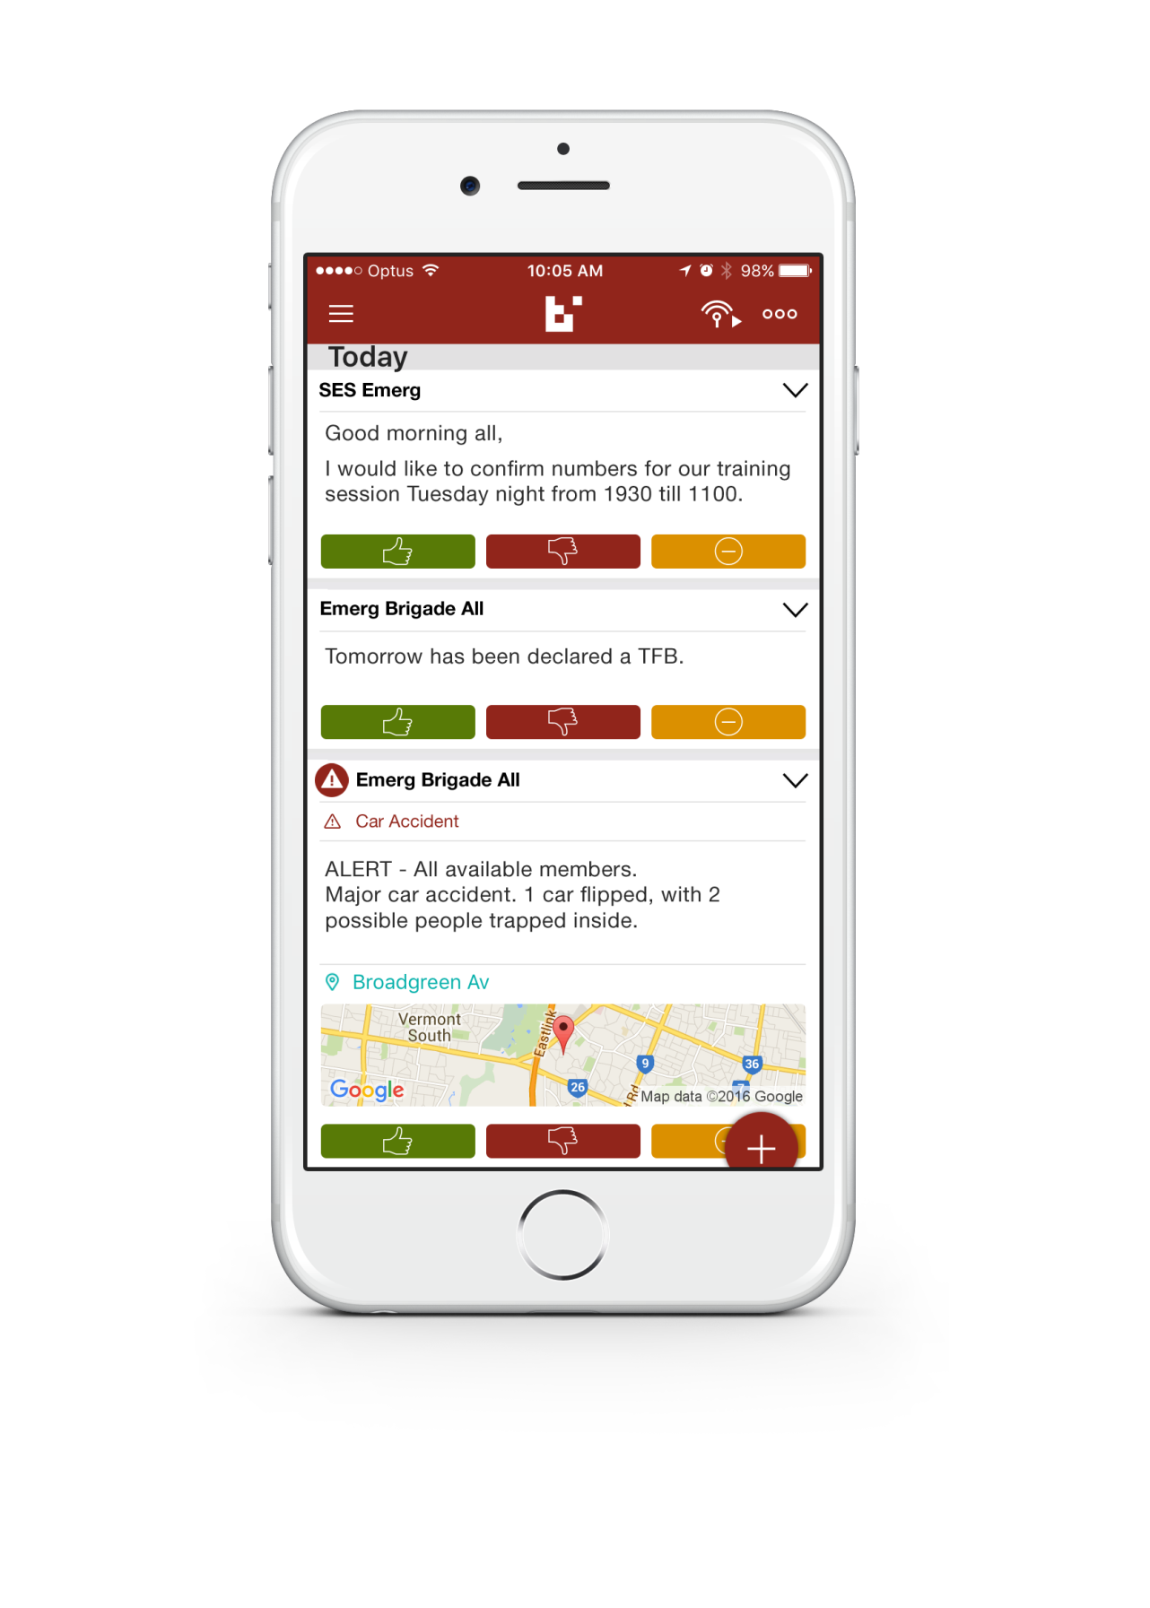
List View Screen
You can toggle between List View and the Quick View screen
In List View you can see at least 2 pager messages
Tap Red Plus Circle to select:
New Team
New Discussion Message
New Broadcast

Slide 11
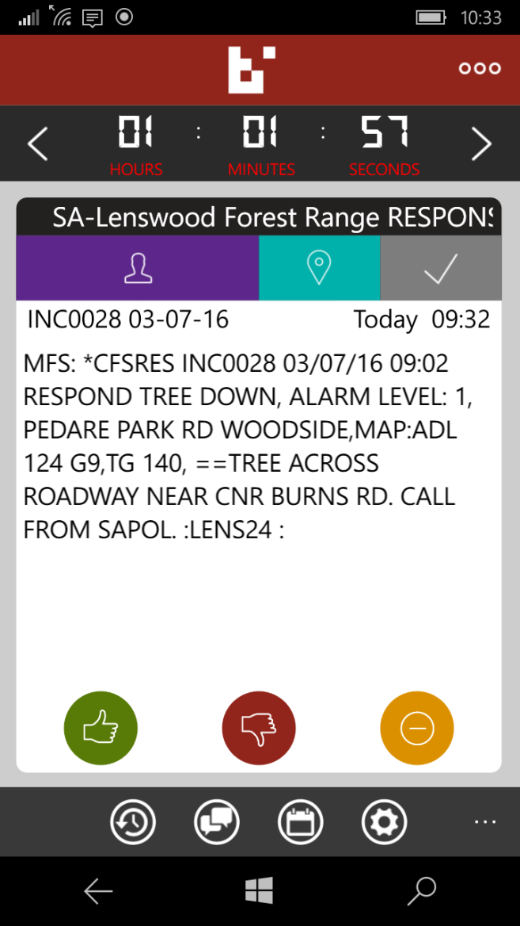
Windows Phone App
Windows Phone app has less features than the Android and iPhone app, however all of the basic features are available
Windows Phone app is slightly different
List View Discussions Availability Settings

Slide 12
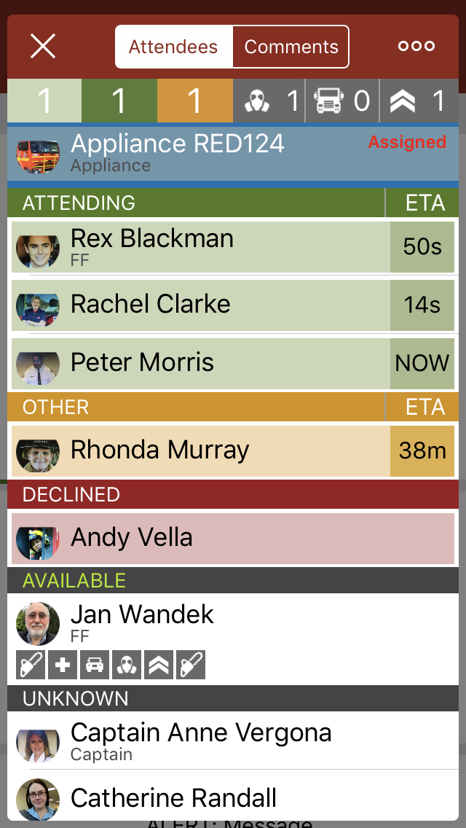
Attendees
Refresh
Goes back to Quick View screen
Qualification by numbers. This feature is not fully enabled yet.
Attendance by numbers. It appears you need the latest app for this to work.
List of who’s attending
List of who is NOT attending
Picks up your Roster’s status

Slide 13
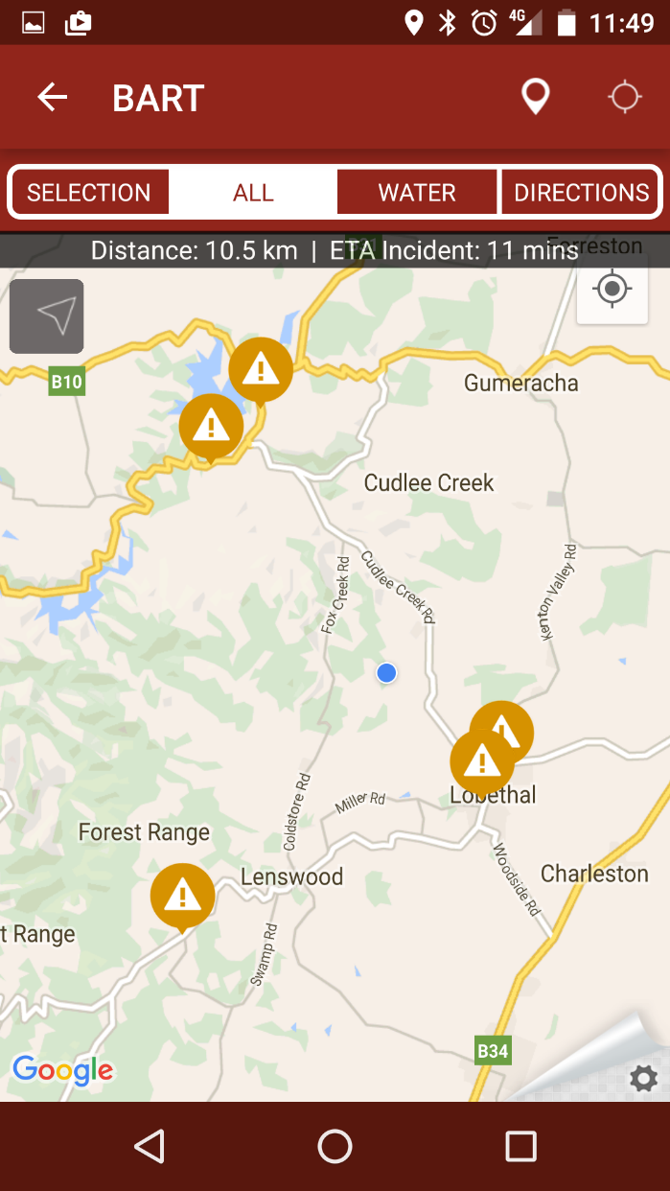
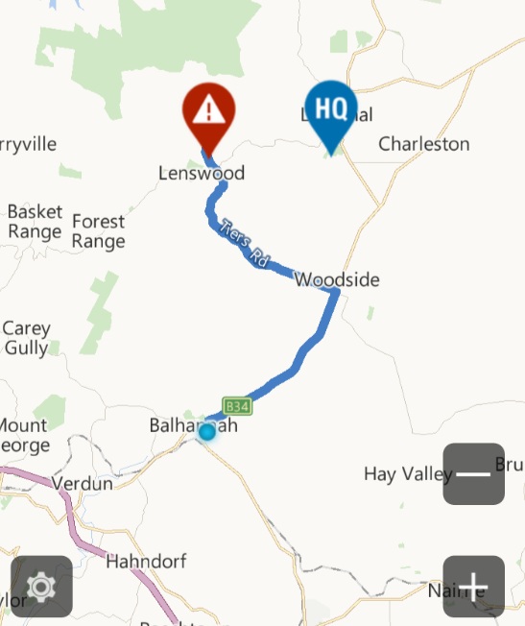
Map Screen
Sometimes BART is unable to pick up the exact location from the pager message. E.g.
Incident location
Your location
@PETALUMA WINES #137/003 254 PFEIFFER RD WOODSIDE,MAP:ADL 137 M3,
If you hold the incident location icon down within the smartphone app, you will be able to move it around to the correct location. Only available on Android and Apple
There is a Wine Ct, Petaluma, California, United States
You can use your smartphone for navigation by following the route marked on the map OR use the directions tab

Slide 14
Checking availability for a total fire ban day or severe weather event:
A pager message will be sent asking who will be available.
Members will use the BART smartphone app to give thumbs up or thumbs down to state their availability.
Users can easily update their status during the day using this method.
Non-smartphone users respond via pre-paid SMS
Checking on Who is Available

Slide 15
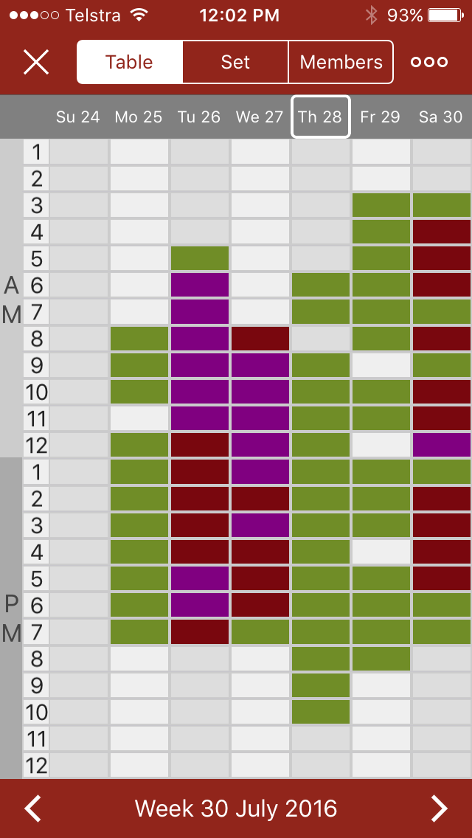
It has been decided by the Group that we won’t enforce the use of the Roster function of BART at this time
We do however encourage its use particularly in the summertime
Members are able to set one of three different statuses:
Available
Not Available
At Premises (station or unit)
What is important is using the thumb up and thumb down buttons
Roster/ Attendance Screen

Slide 16
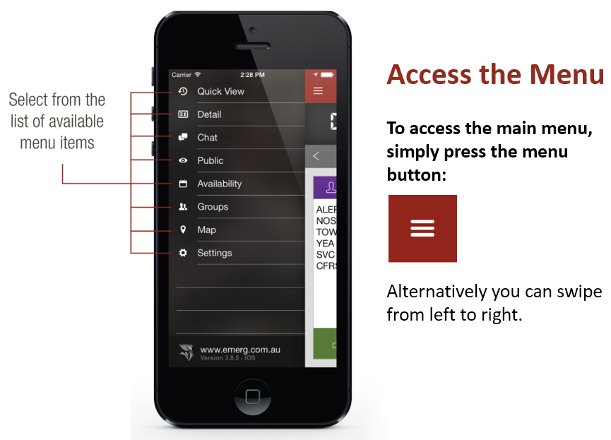
Settings allows you to change Tones and other features
Roster/ Attendance Screen

Slide 17
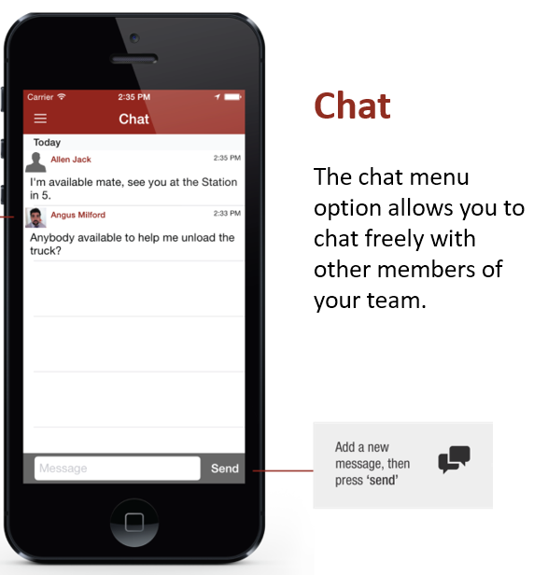
Discussions are not visible on the Quick View screen
Discussions can be held between BART members of the same team. Basic text messages can be shared, as well as specific locations, images stored on your device, or you can take a photo to share
Your brigade has the ability to setup multiple teams to communicate with your brigade members. e.g. The Management Committee
Discussion/ Chat Screen

Slide 18
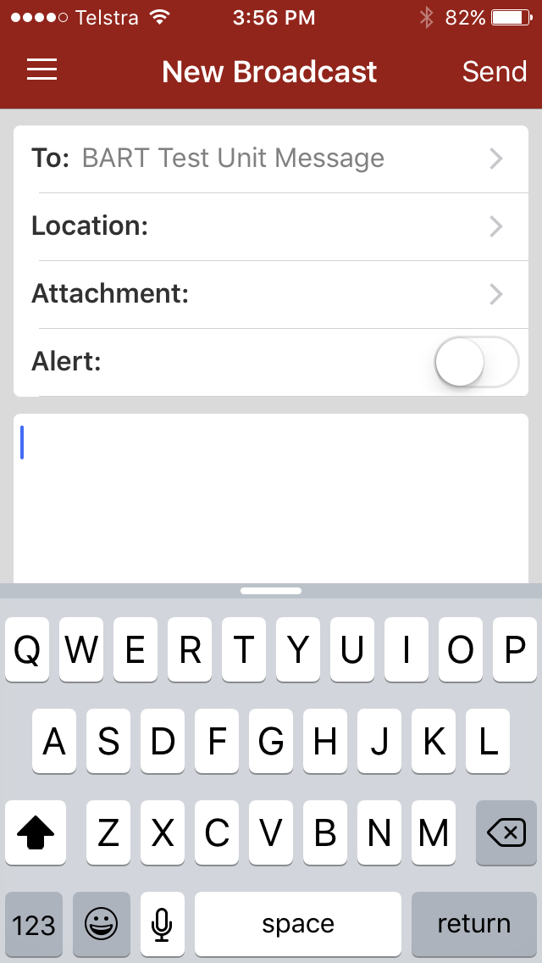
Broadcasts are another way of sending messages.
You can add an alert tone Note: the Alert Tone tick box
A Broadcast message appears on the Quick View Screen
To be able to send a Broadcast on a phone you need permission from your Brigade Admin
It’s possible to send a location through BART via a Broadcast.
If this example was sent you could open the message and BART will help you navigate to specified location.
Message/ Chat Screen

Slide 19
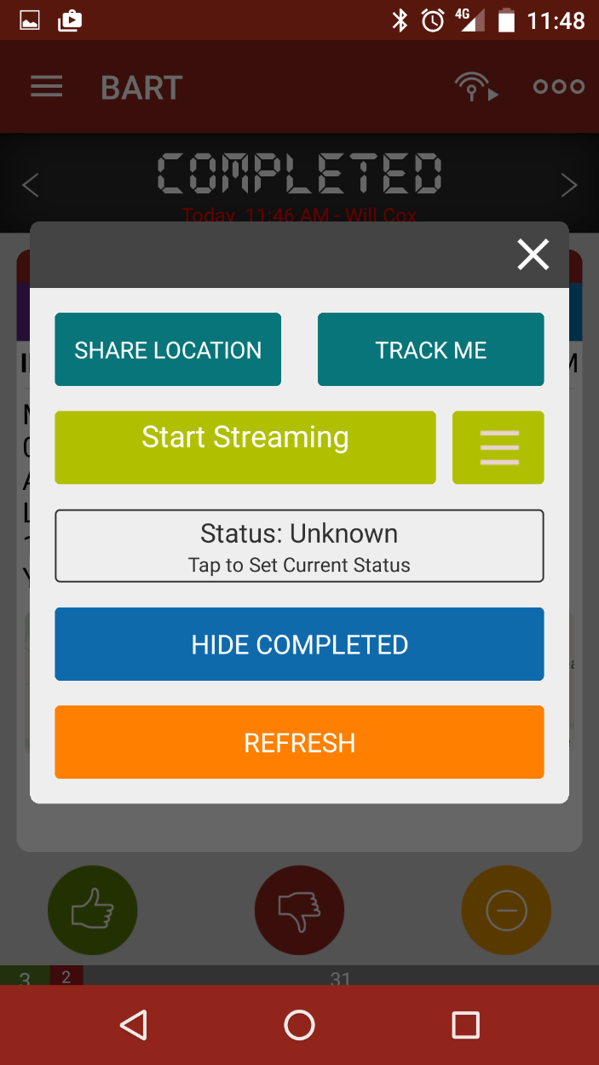
This will show your current location on the Dashboard but not track you
Note: Your location will stay within the system for 1 hour
The three dots starts this box
The Track Me feature will track you on the Dashboard
Note: Tracking will stay enabled for 1 hour
Allows you to listen to GRN streaming
Selects streaming source
Updates your Roster. Will change colour depending on your availability
Hide Completed Jobs
Updates and closes this screen
Advanced Options (3 dots) Screen

Slide 20
Other Information – 1/2
GDO’s will join each brigade so they can see who is responding. Be aware that GDO’s will see your brigade discussions.
GPS tracking is available to view individuals responding to an incident from work or home via the BART Dashboard (internet site). This use is optional. It can also be beneficial for tracking a private vehicle carrying sandbags or tracking food travelling to the fire ground.
Your BART smartphone will estimate your time of arrival to the station if you have GPS tracking enabled on your phone. It may also pick up your location from your home WiFi.

Slide 21
Other Information – 2/2
BART broadcasts may be used to send important information to all members of the Group or a single brigade (who have a smart phone). For example: GDO sends Strike Team assembly location along with an information message. We will continue to test this feature before relying on it.
BART has the ability to set up teams. This feature is optional for brigades to use. Feel free to experiment with this feature. If you come up with any good ideas let your BART brigade reps know.

Slide 22
Summary
The ‘must do’ as an individual member of the brigade is to hit the thumbs up or thumbs down button when you receive a BART response message. You will find the Chat/Discussions valuable so please respond when asked a question. It’s up to you how you use the other functions.
You can’t rely on technology to work all of the time. BART is an aid to help us and doesn’t put the fire out so don’t forget your CFS training.
BART is a good solution for our response needs. More new features will be available in the future which will only make it better.

Slide 23
?
Questions?

