Slide 1
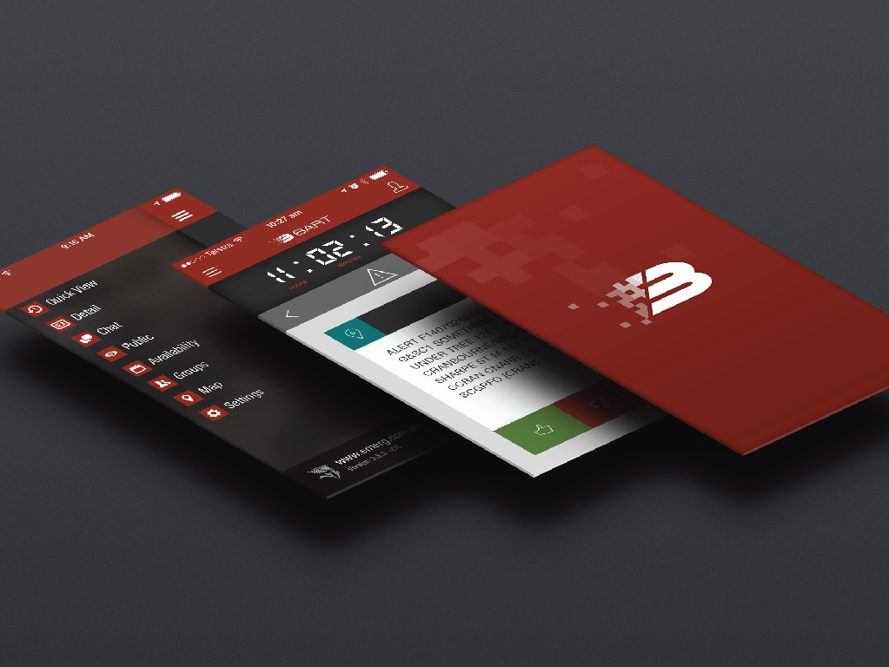
BART App Walkthrough
For new BART users

Slide 2
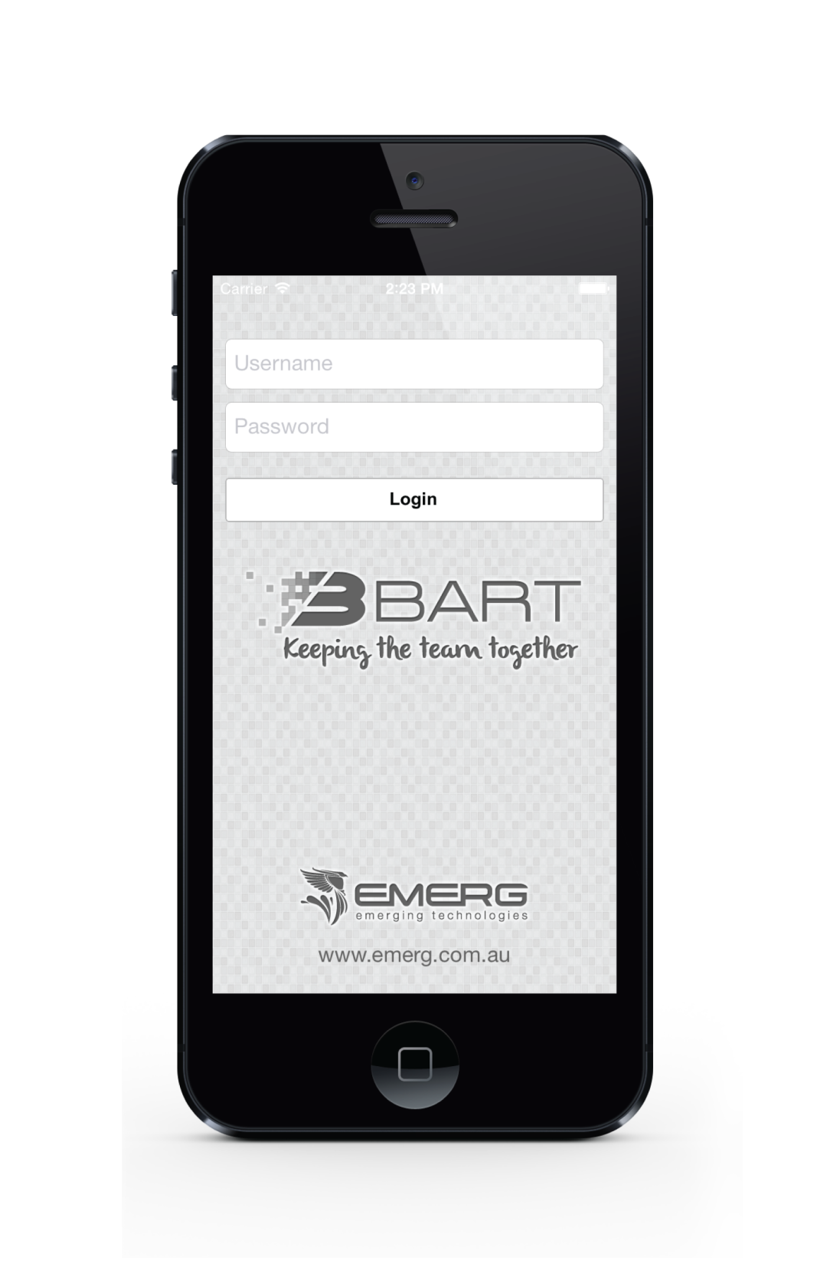
Lets get started!
First you will need to download the BART app for your device.
Open up your BART app by pressing the icon on your phone, and enter in your login details.
b
s
r
a
r
t
u
e

Slide 3
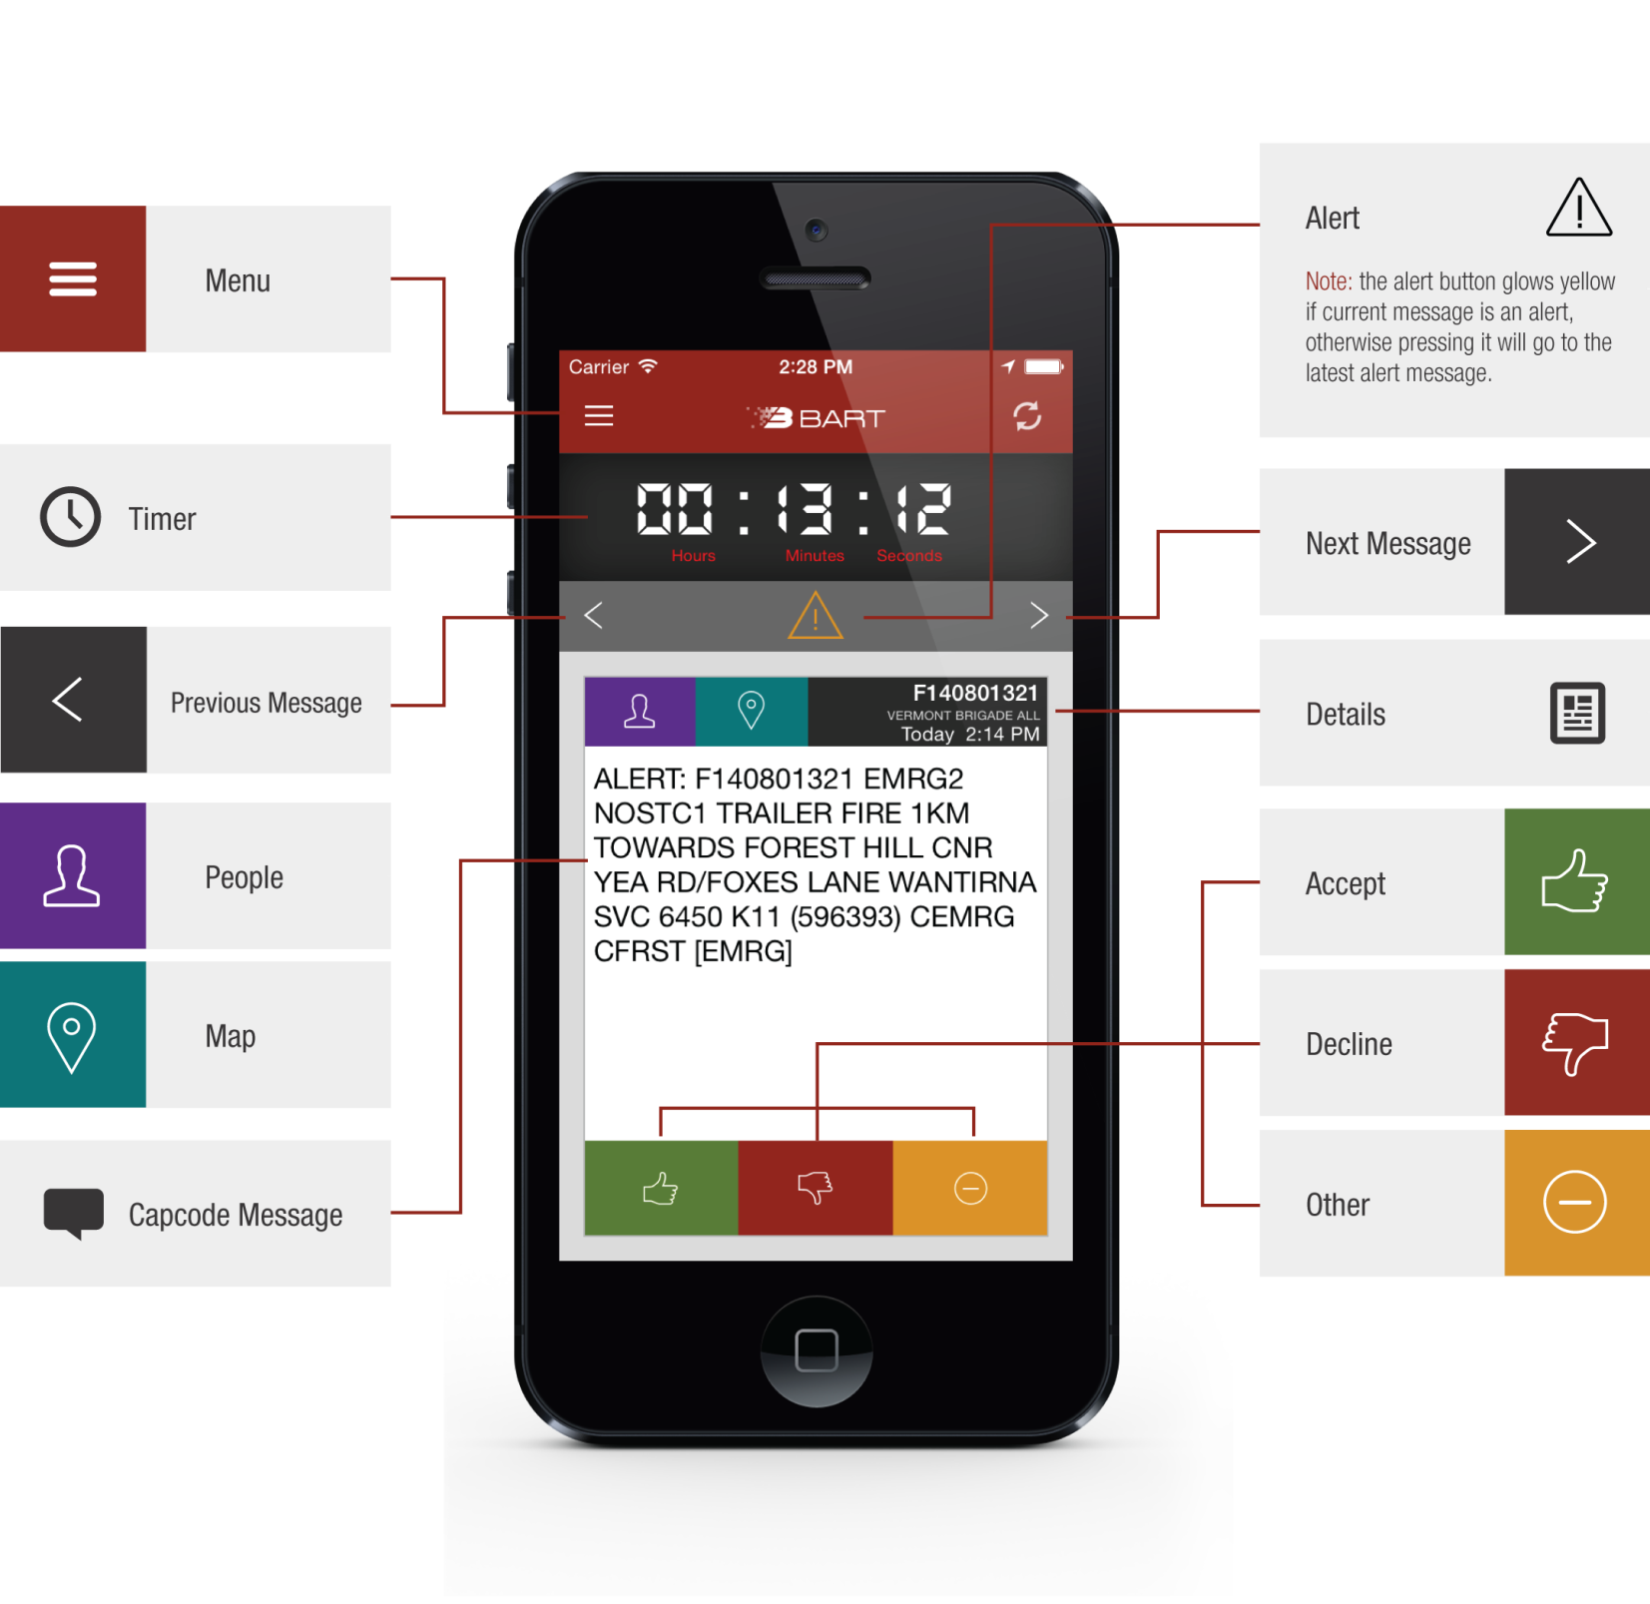
The Main Interface

Slide 4
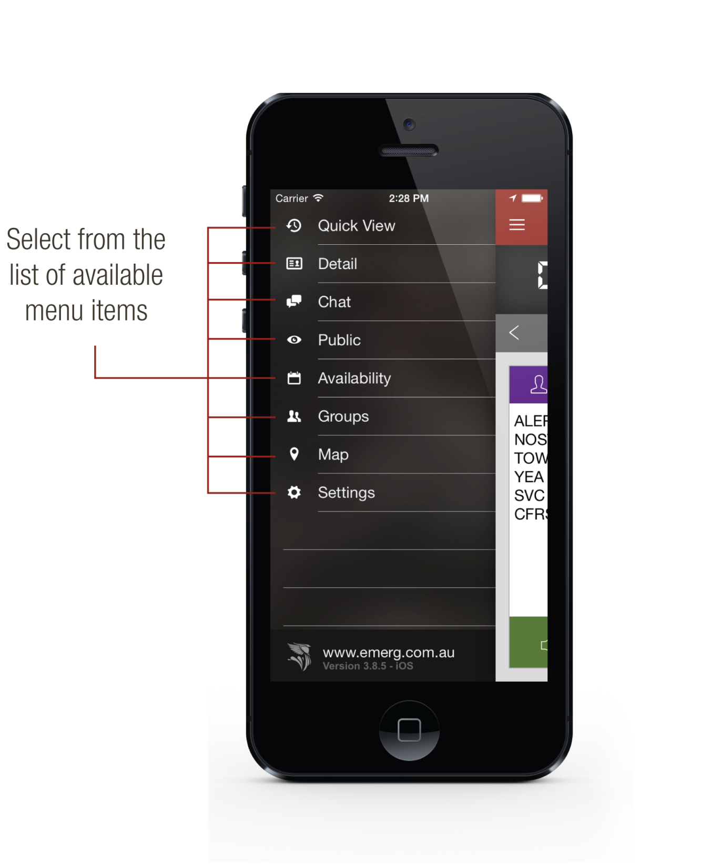
Access the Menu
To access the main menu, simply press the menu button:
Alternatively you can swipe from left to right.

Slide 5
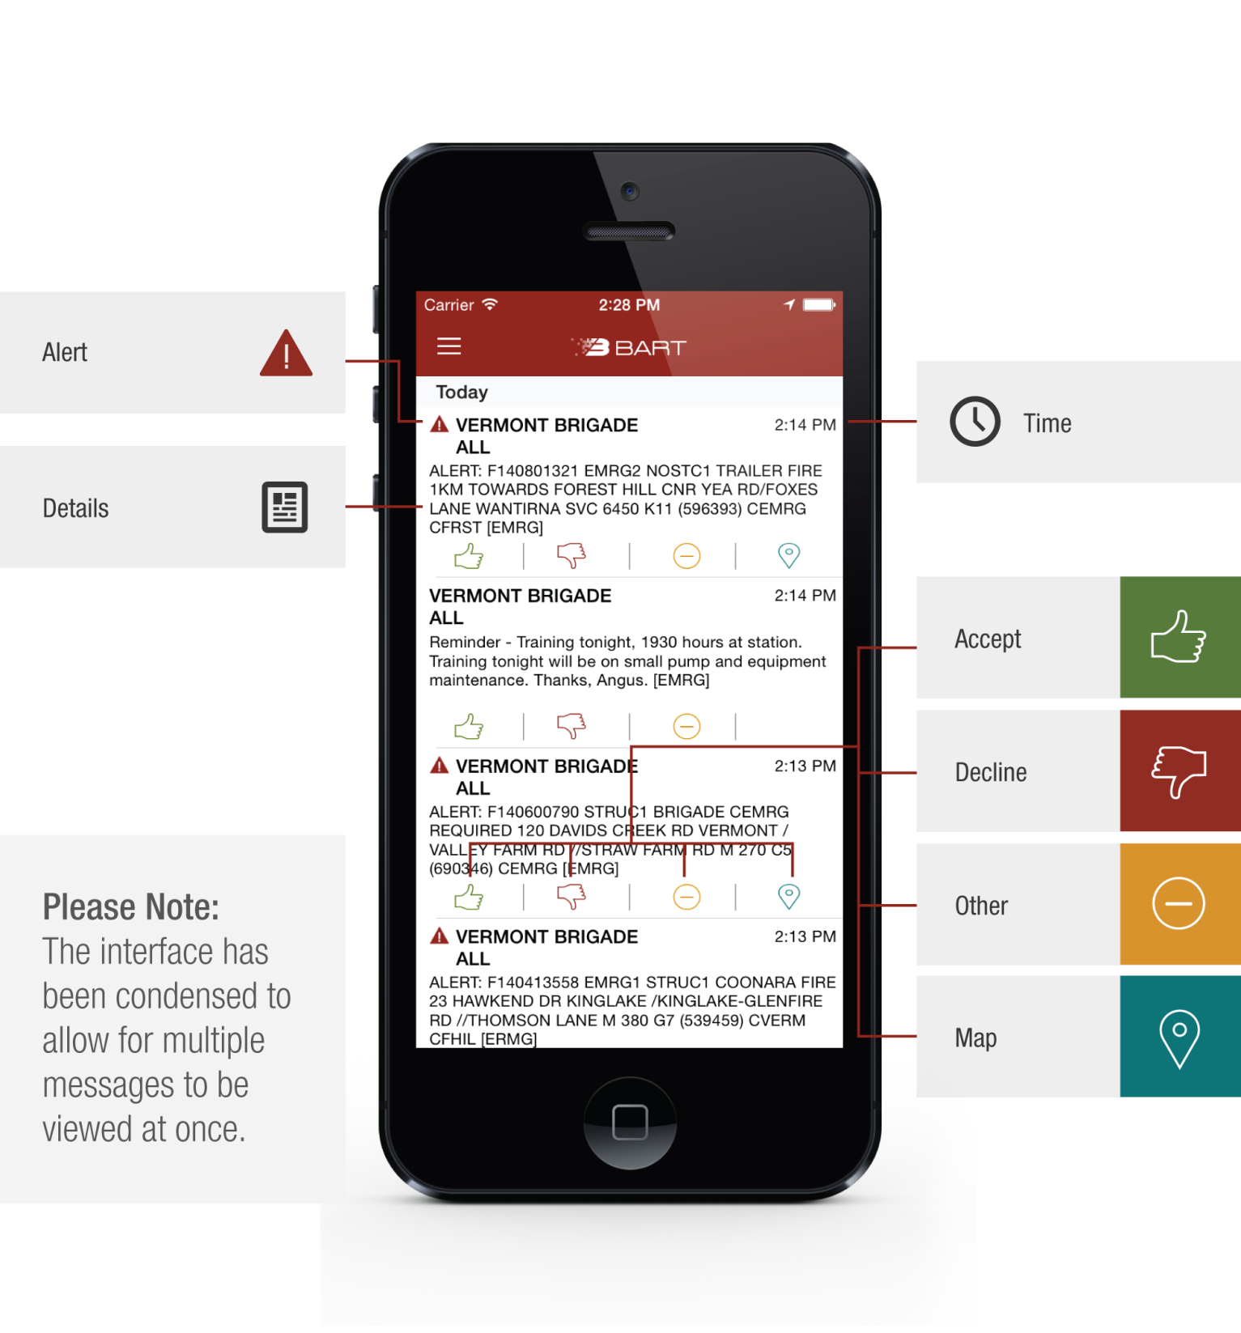
Detailed View

Slide 6
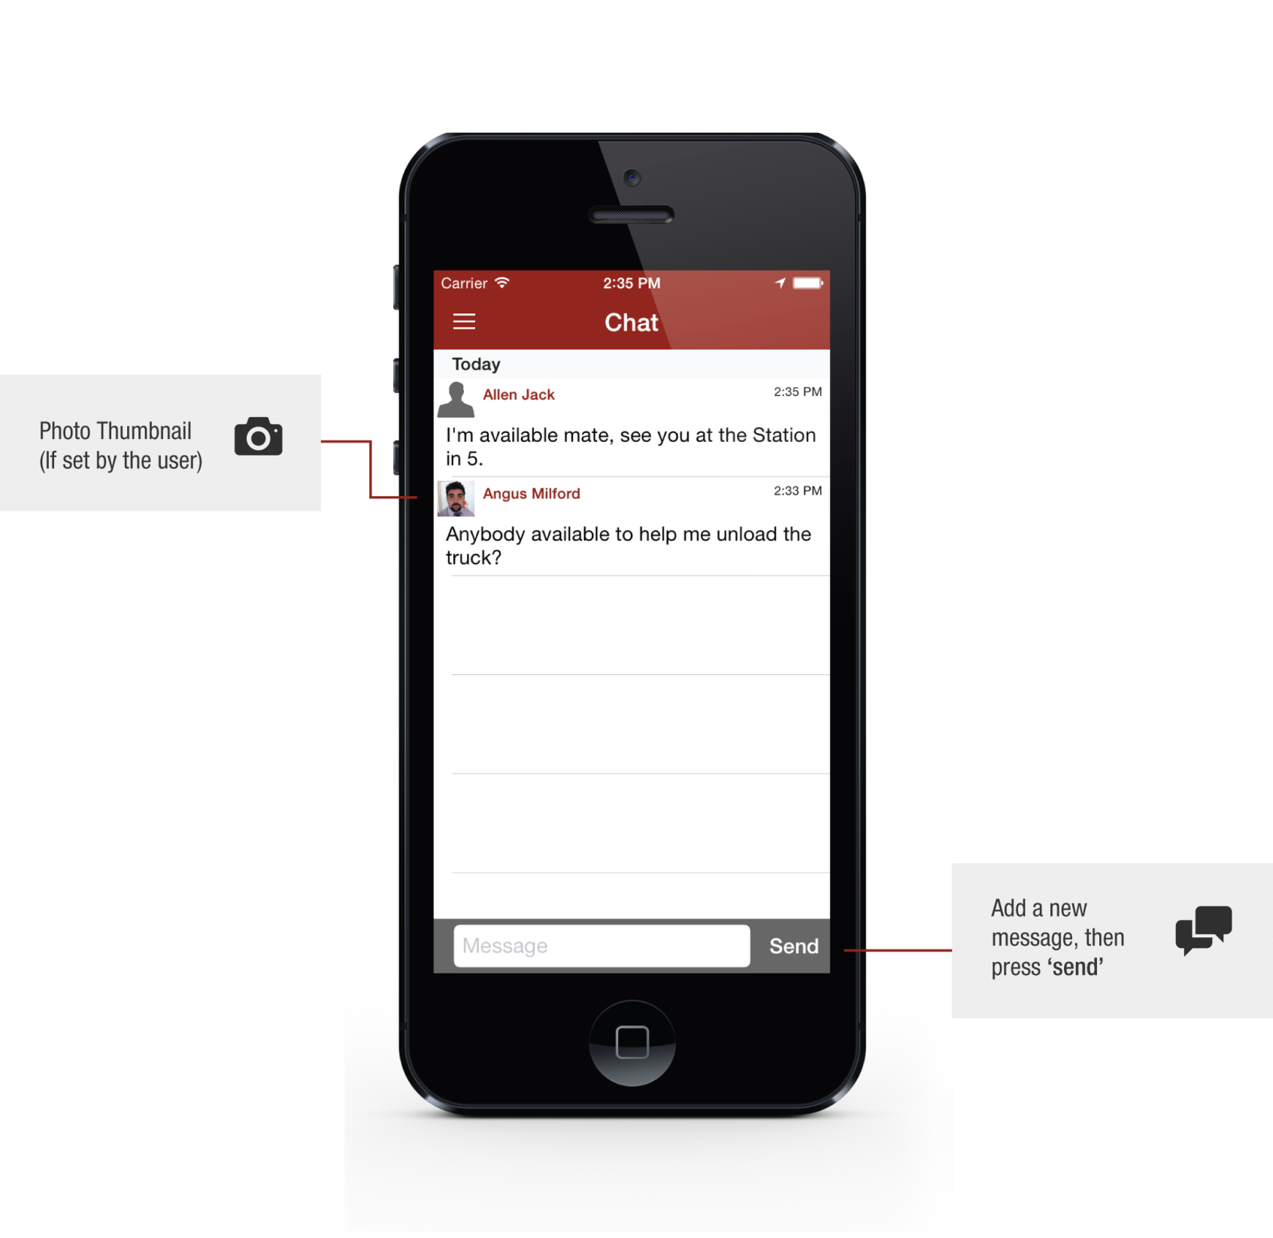
Chat
The chat menu option allows you to chat freely with other members of your team.

Slide 7
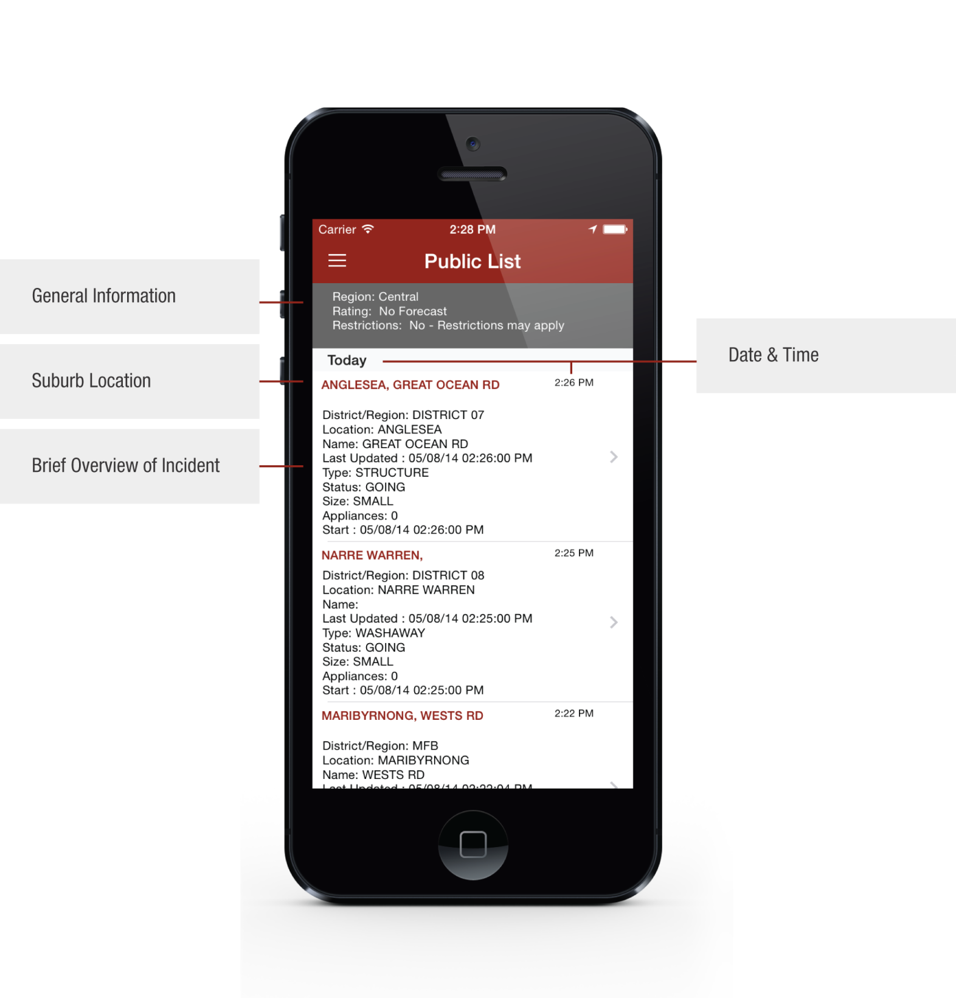
Public List
The public list displays a feed of information that is available to the general public.

Slide 8
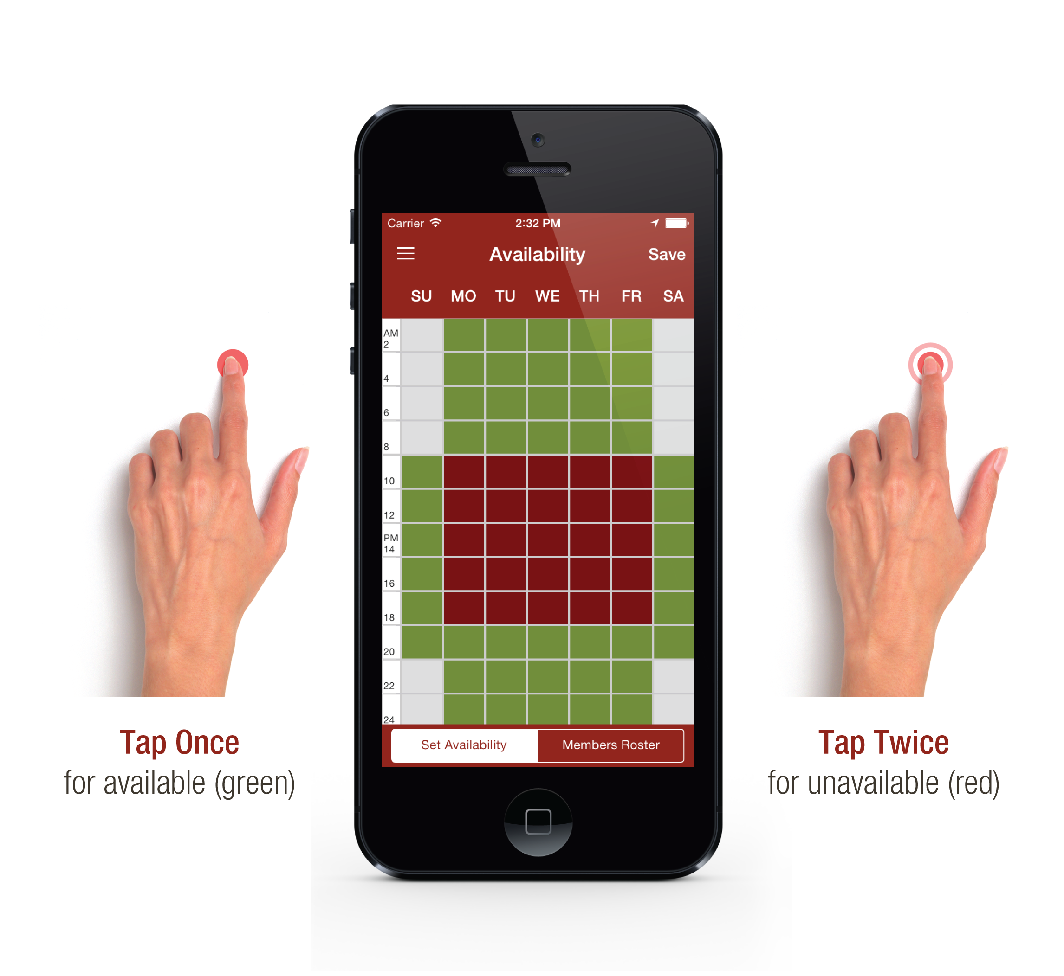
Availability

Slide 9
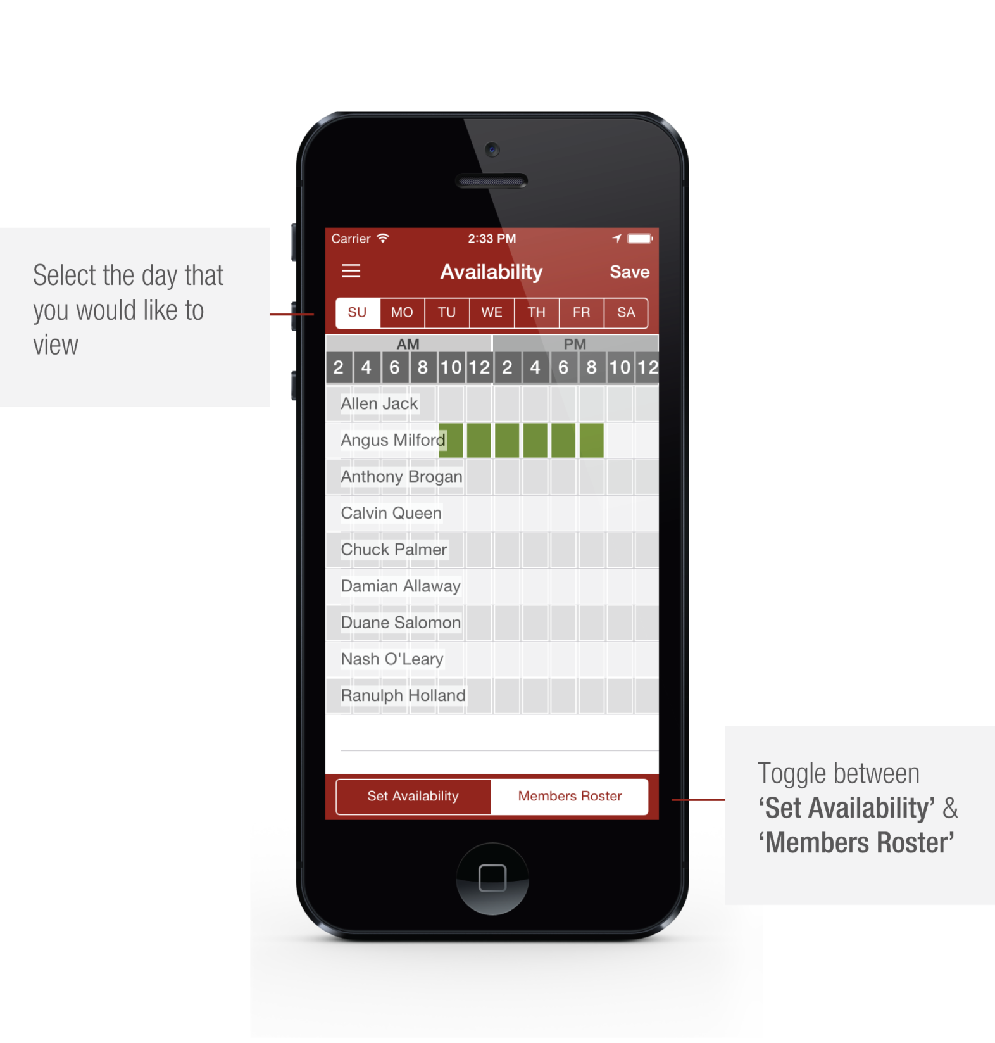
Members Roster
View the availability of other members of your team.

Slide 10
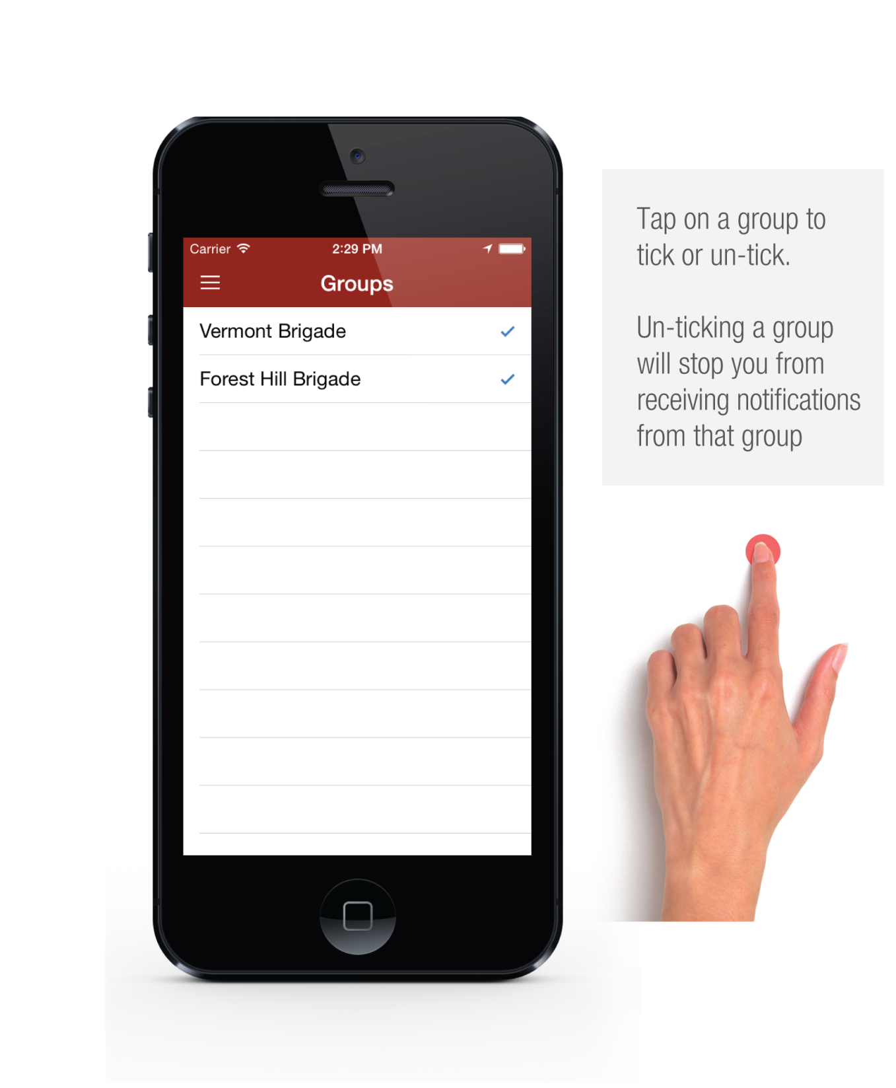
Groups
View the groups you belong to and choose the groups that you want to receive data for.

Slide 11
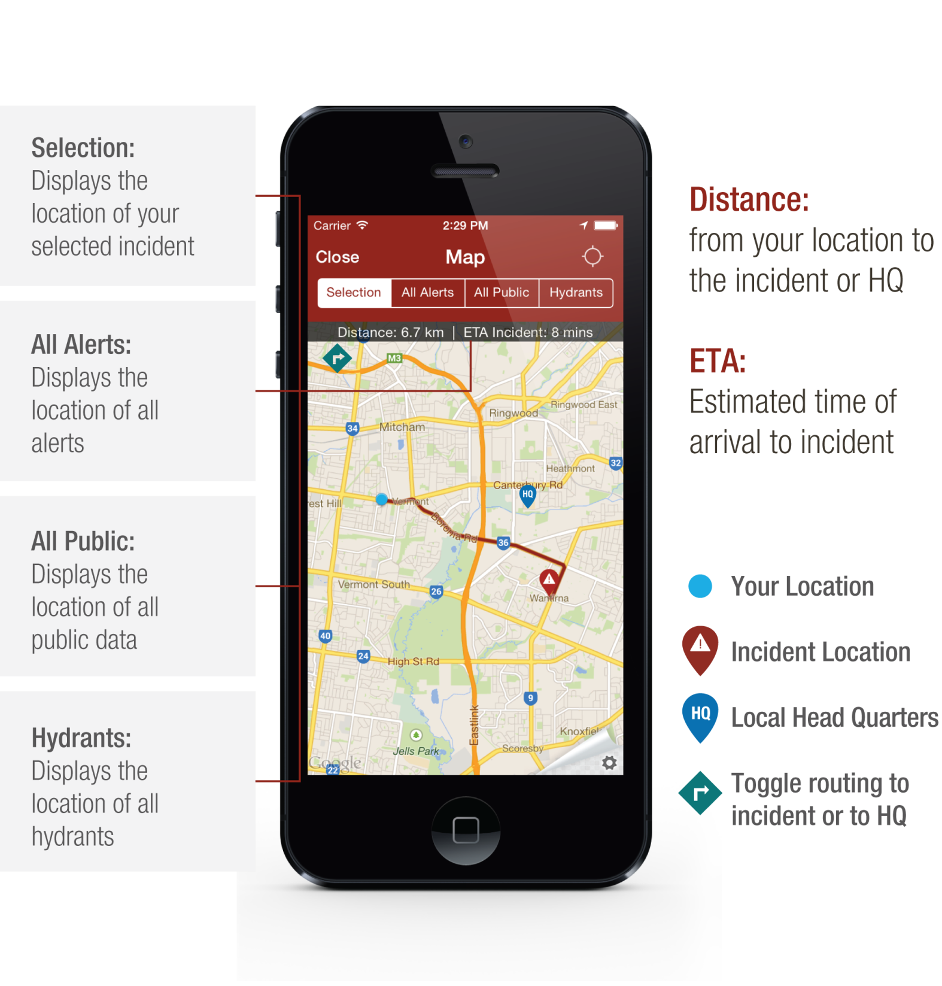
Map

Slide 12
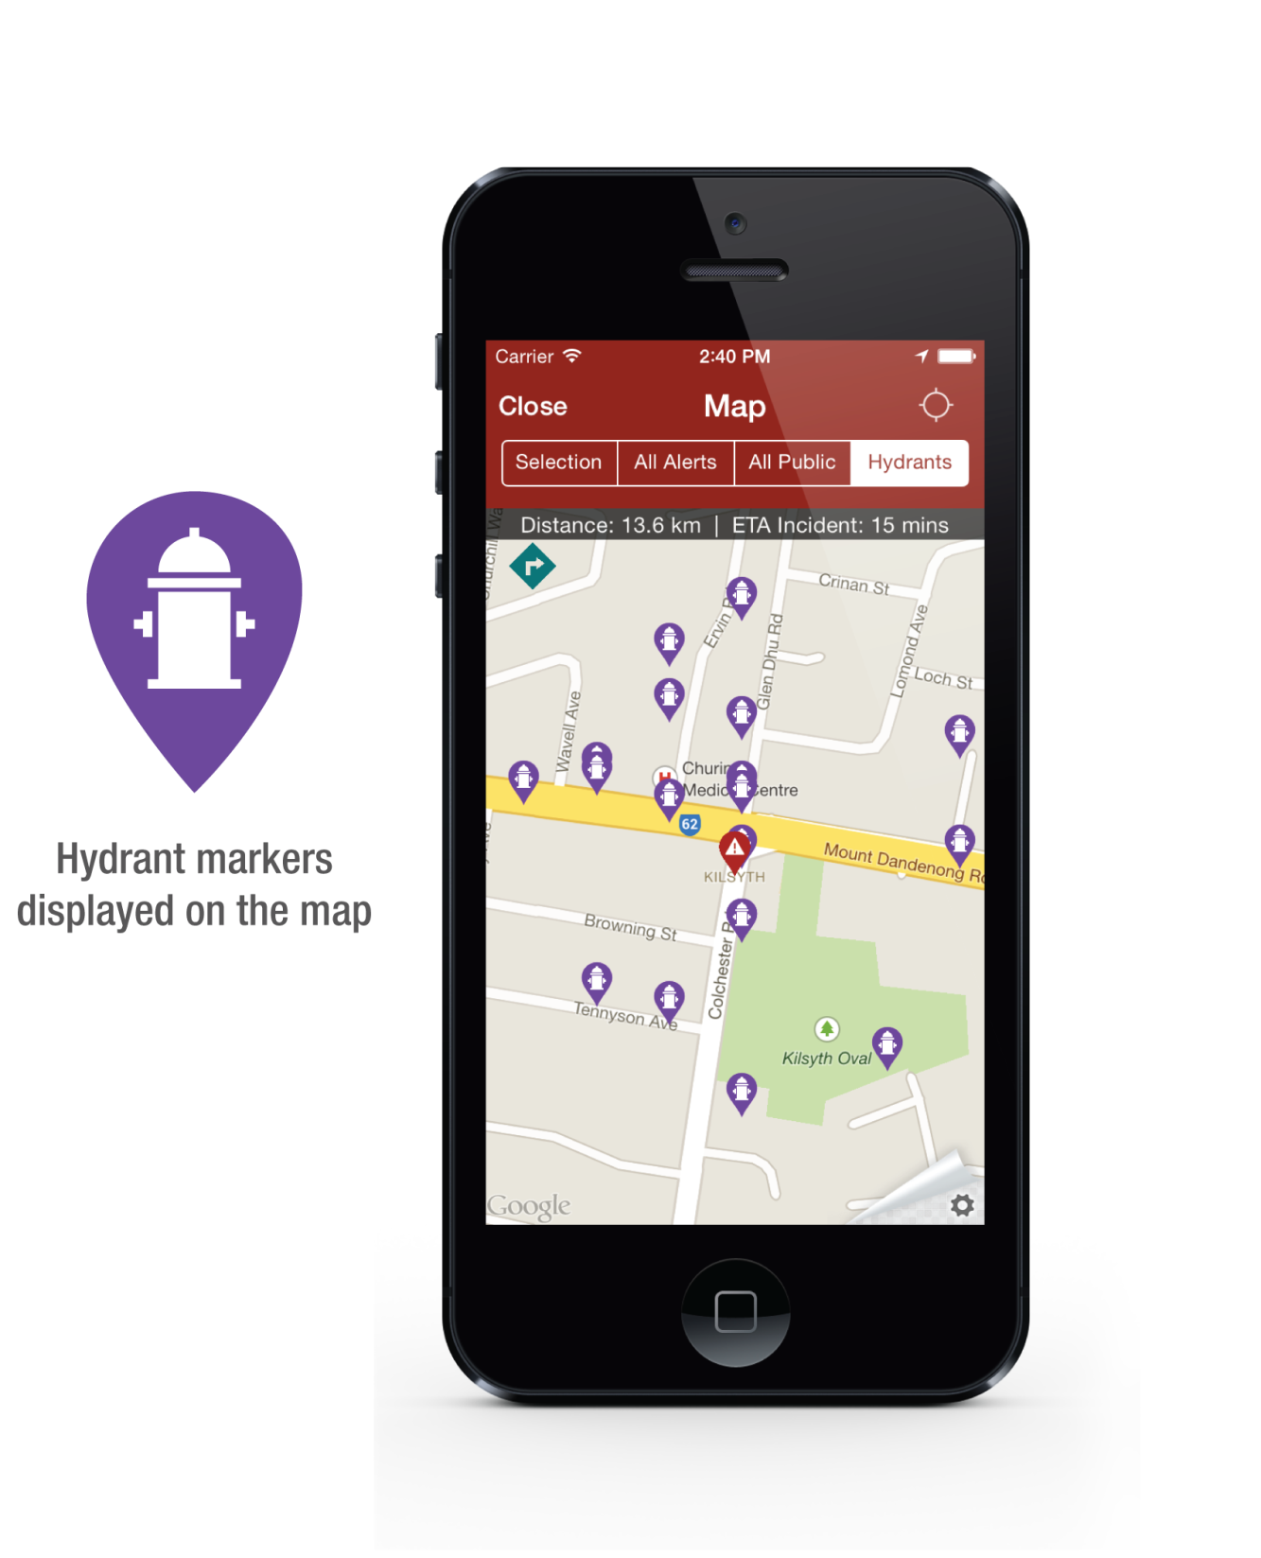
Map (Hydrants)

Slide 13
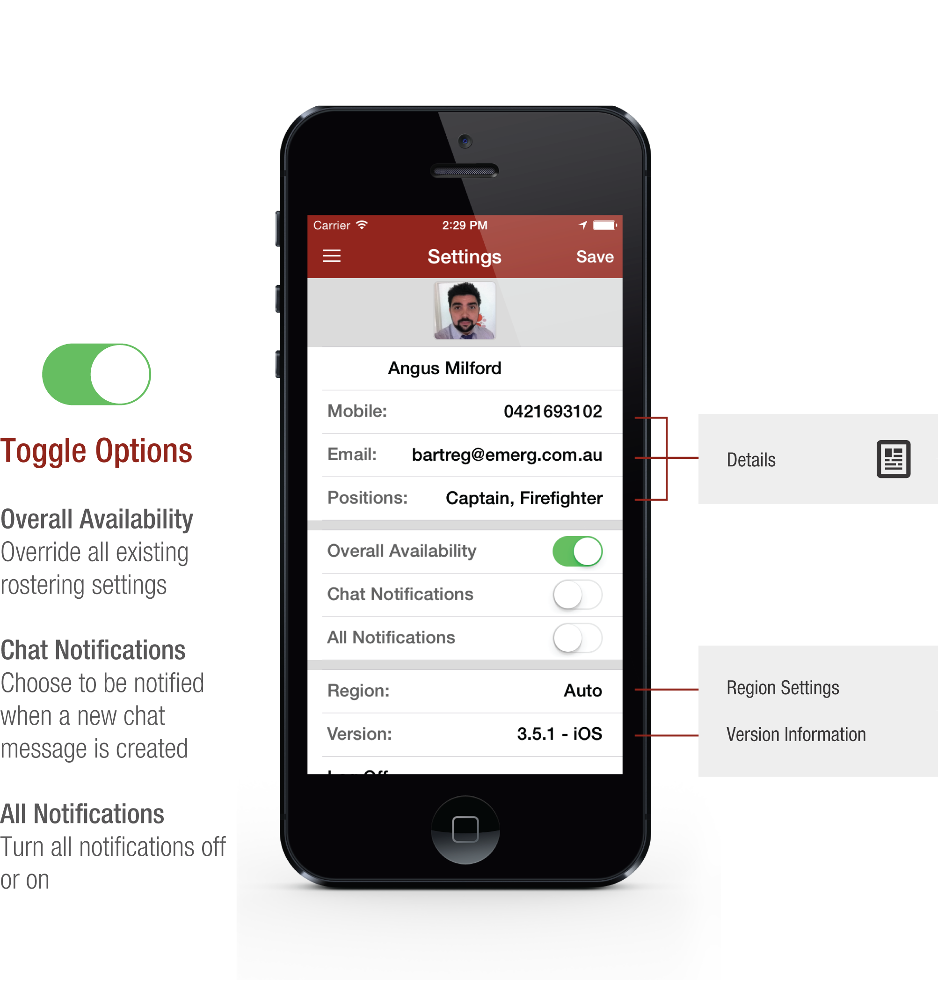
Settings

Slide 14
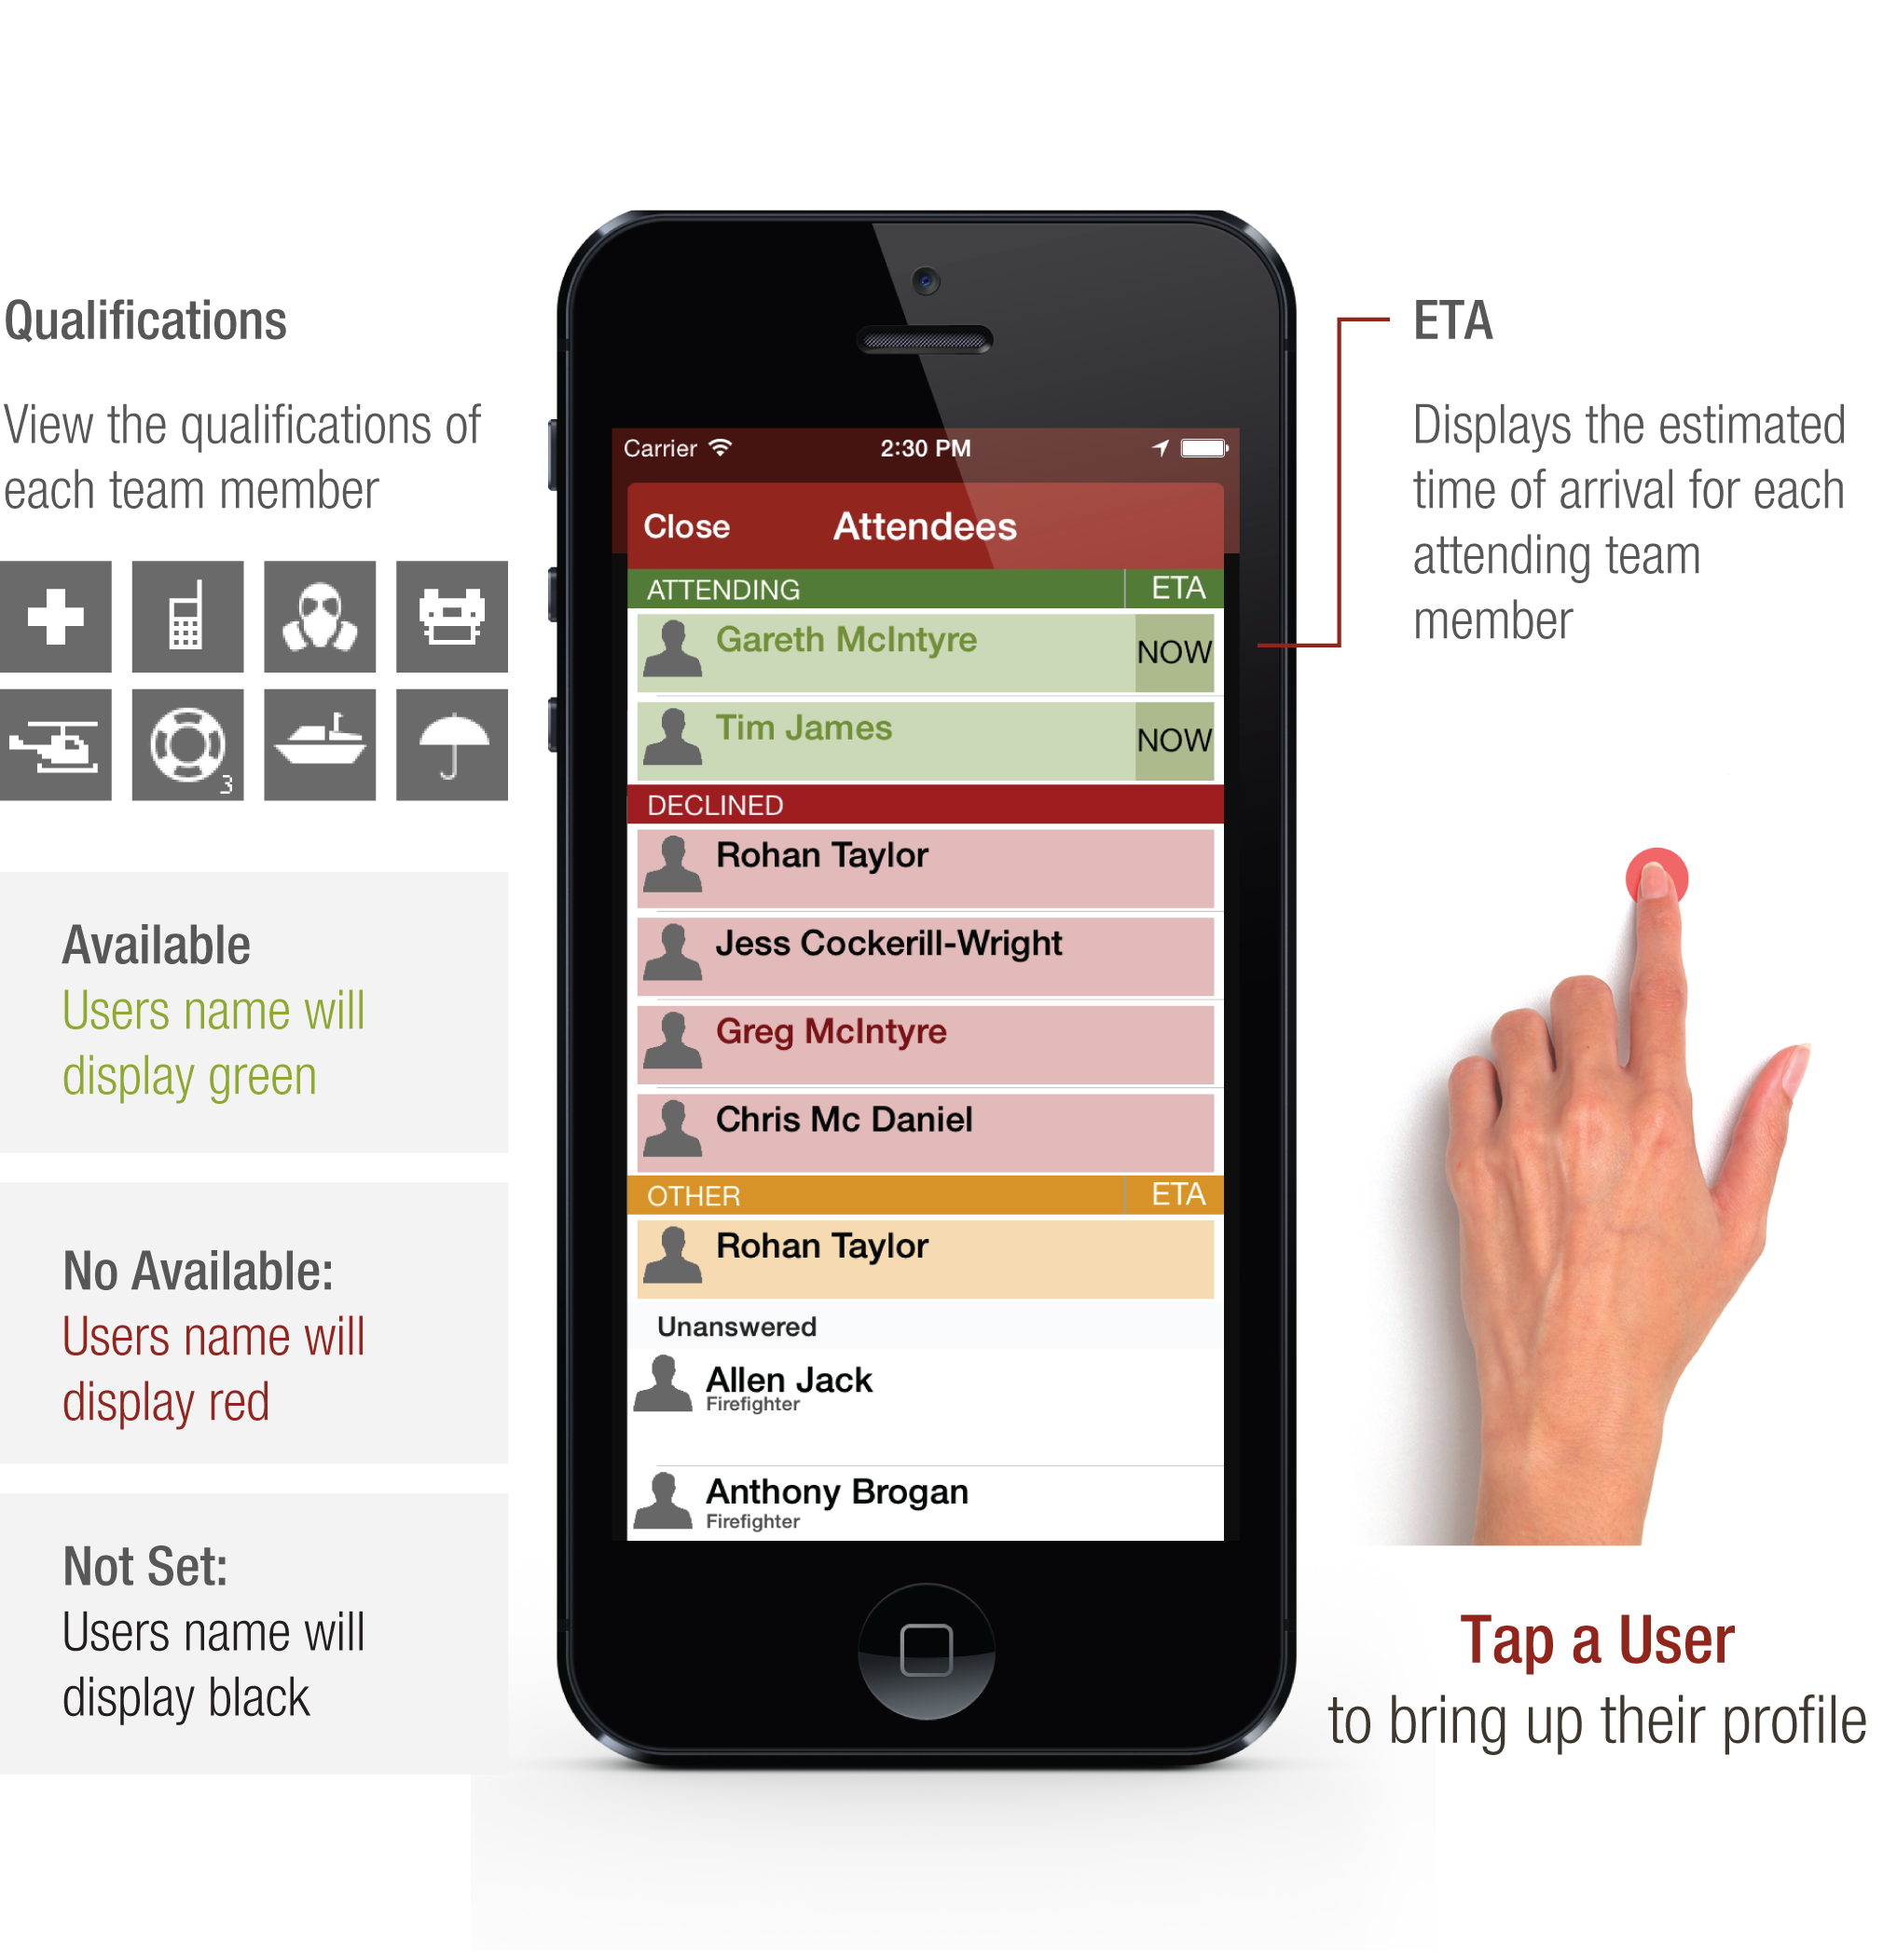
Attendees

Slide 15
Proudly brought to you by

