Slide 1


Check-In Module
OVERVIEW
FEB 2026

Slide 2

CHECK-IN OVERVIEW
CONTENTS
Overview
Who can Check-in?
How to Check-in (BART App)
How to Check-in (QR Code)
How to Check-out
Check-in Data

Slide 3
OVERVIEW
WHAT IS IT, AND HOW DOES IT WORK?
The BART Check-in module has been developed to improve the visibility of member activity.
Instead of manually tracking time and attendance, Members can quickly log their hours and activities directly in the BART app.
Requires the latest BART App release.
The Check-in module allows Members to:
Record their time and activities
Categorise activity by type and link an Event, or Incident to the check in
Add notes for additional context
View their own check-in history
For management teams, Check-in provides:
Centralised time and activity records
Visibility of Member participation
Accurate reporting against brigade requirements
Track External personnel visiting your location

Slide 4
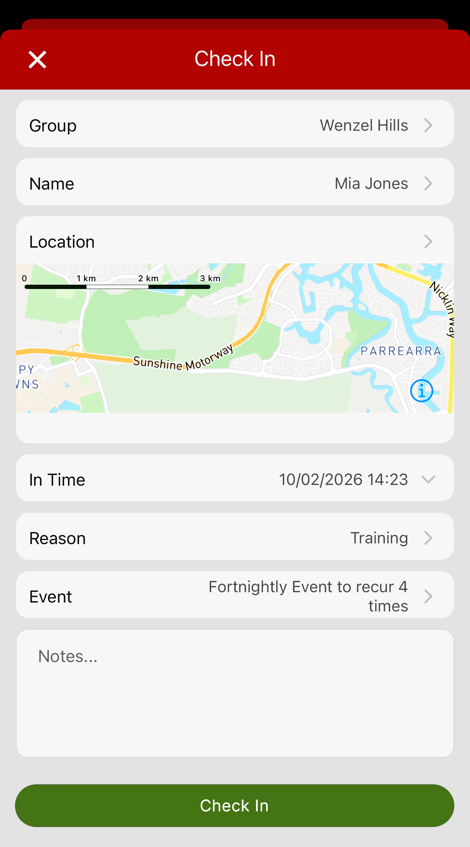
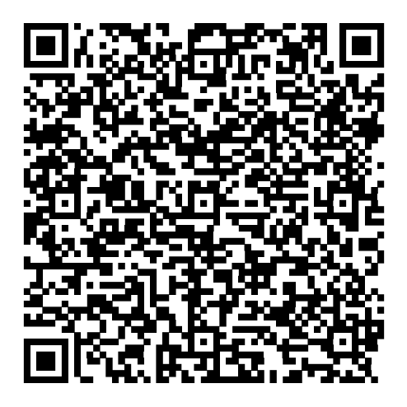
WHO CAN CHECK-IN?
BART MEMBERS + EXTERNAL CONTRACTORS
BART Members
Check-in via the BART Smart Device App
Associate an Incident or Event to the check-in
View a history of their own check-ins
View the check-in status of other Members in their Group
External Contractors
Check-in via QR code
QR Codes/ Tokens are created by BART Admin
Contractor details and time logged within the system

Slide 5
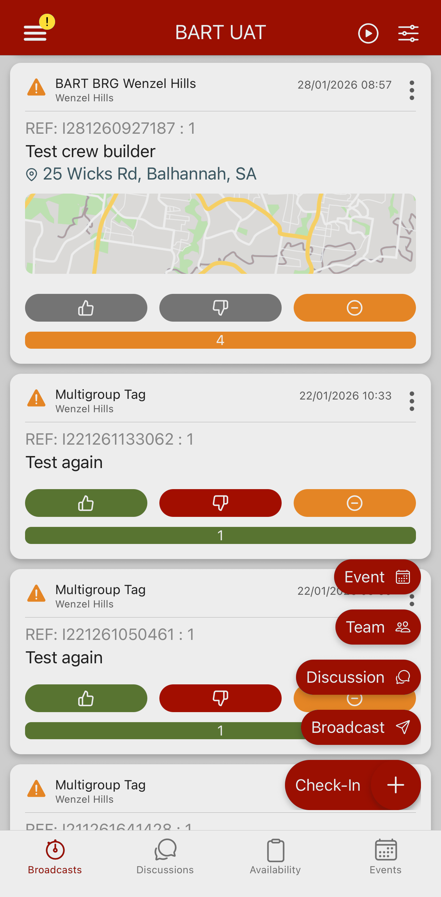
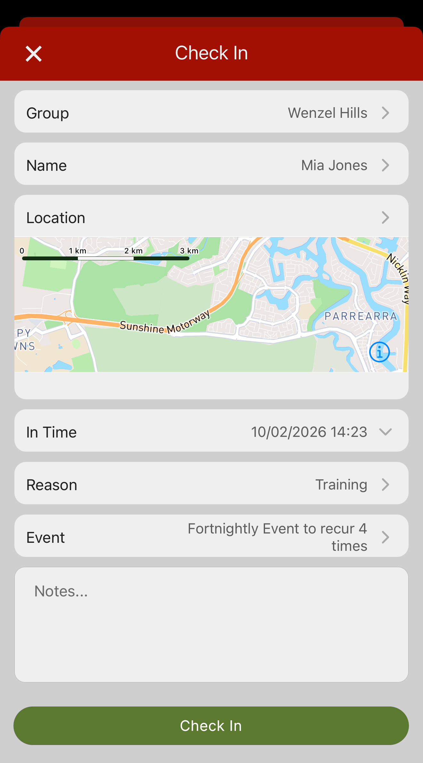
HOW TO CHECK-IN
GENERAL PROCESS (BART APP)
Check-in via:
Check-in Screen (main menu)
Plus Button (List View)
Quick Options (abacus icon)
Select your:
Group
Name
Location
Time
Reason (Operational, Maintenance, Training, Administration, Other)
Notes

Slide 6
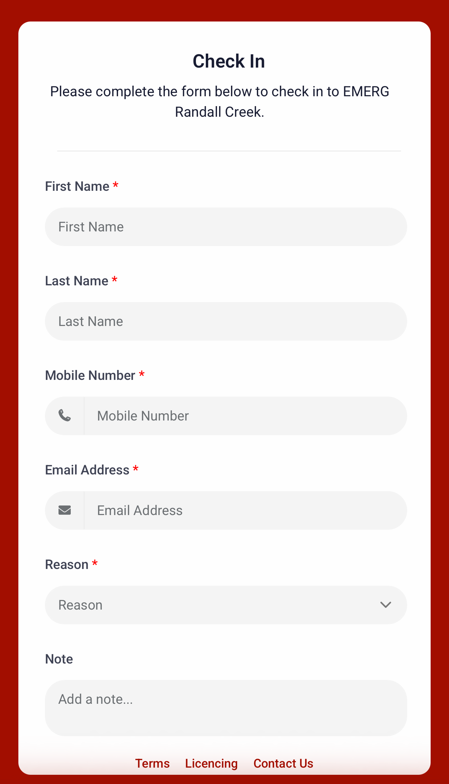
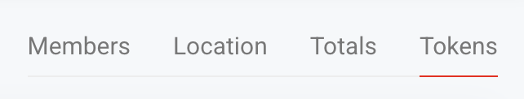
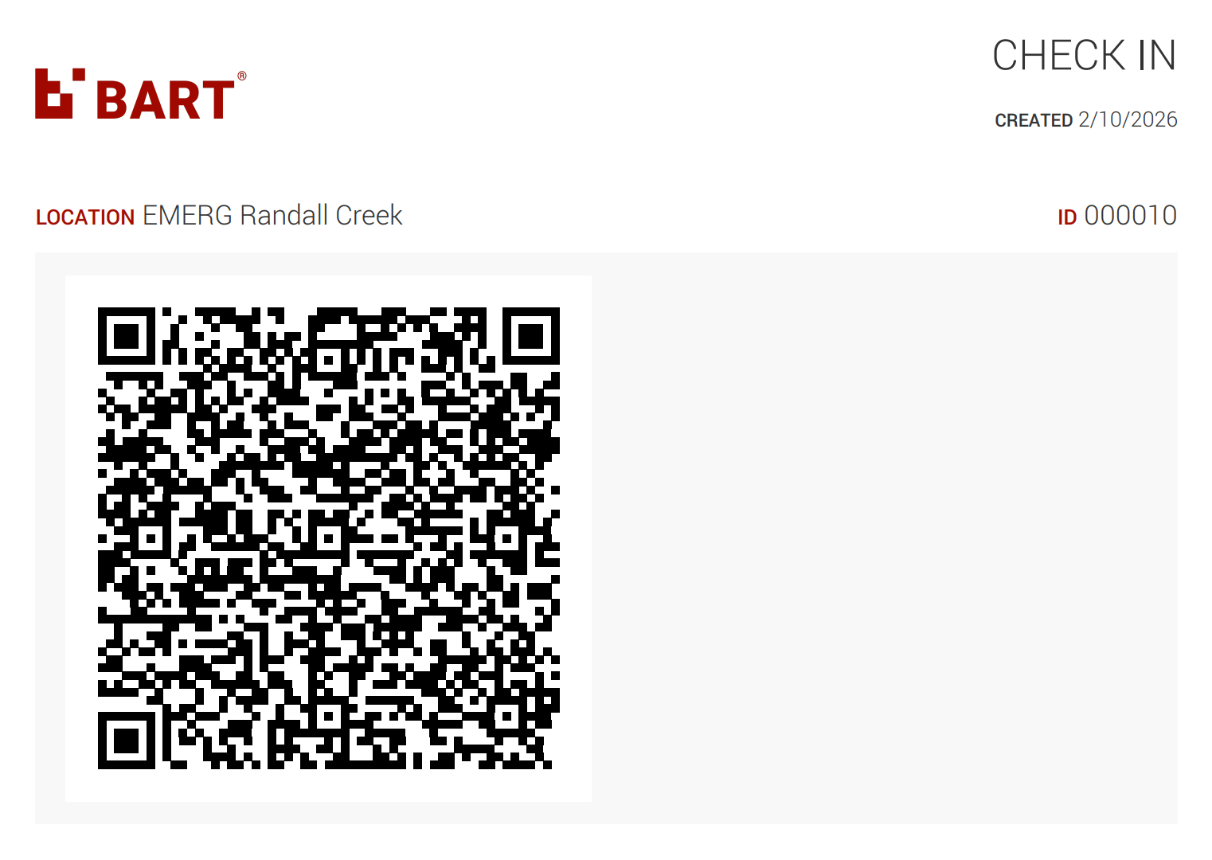
HOW TO CHECK-IN
GENERATE A QR CODE FOR CONTRACTORS
Doesn’t require the BART App or Membership
You need Administrator permissions
Go to the BART Admin Portal: https://bartapp.net/webapp
Click ‘Check-Ins’ in the main menu
Click the ‘Tokens’ tab
Generate New QR Token
Print out, or display on a device

Slide 7
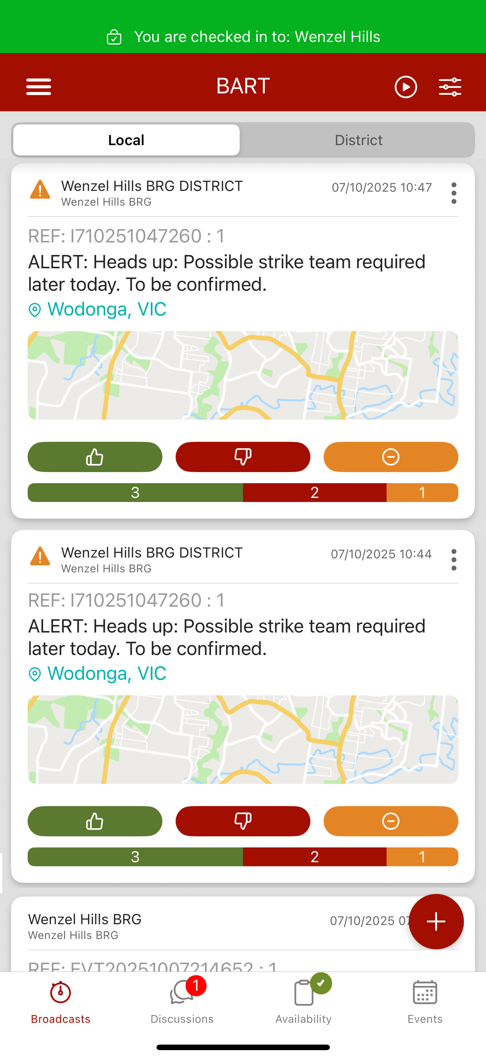
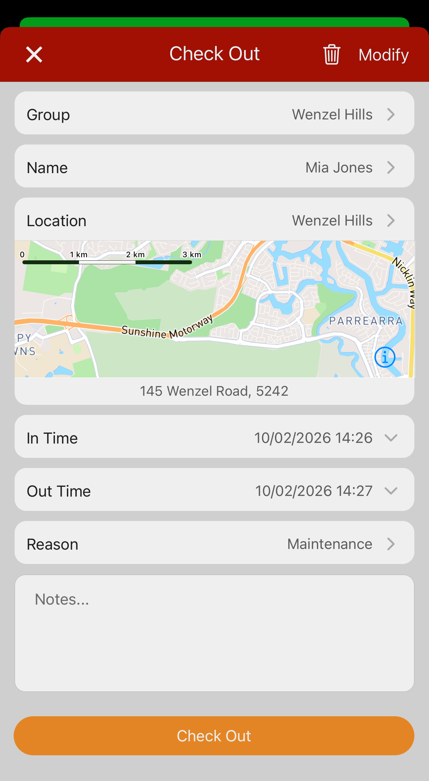
HOW TO CHECK-OUT
GENERAL PROCESS (BART APP)
Check-out via:
Tap the Green Banner
Go to the check-in screen (Main Menu, plus button in List View, Quick Options)
Select your:
Check-out time
Add notes if required

Slide 8
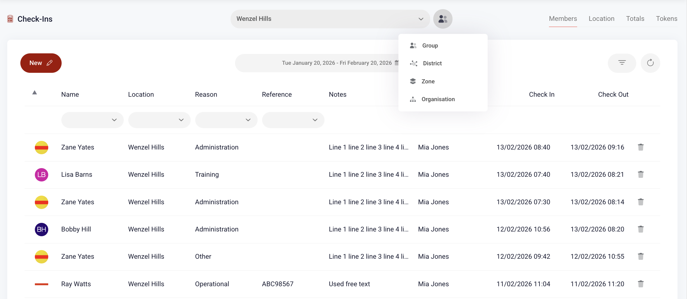
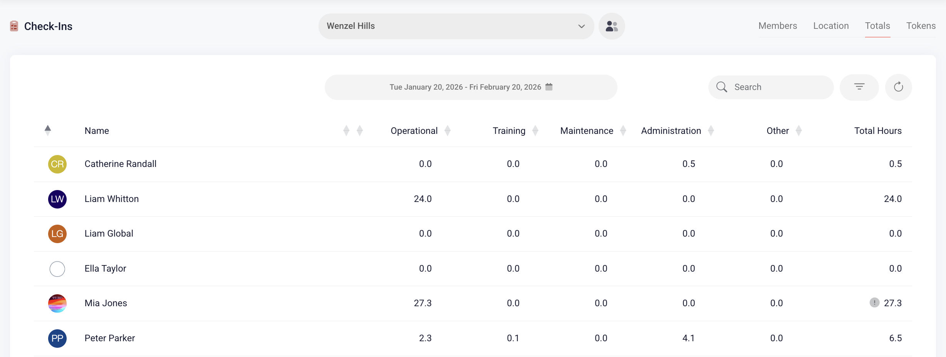

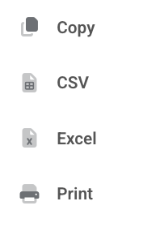
CHECK-IN DATA
GENERATE REPORTS
Go to the BART Admin Portal: https://bartapp.net/webapp
Click ‘Check-Ins’ in the main menu
Use the tabs to navigate to:
Members
Location
Totals
Tokens
Click the Export button: Copy, CSV, Excel, Print

Slide 9

MORE INFORMATION
VISIT THE KNOWLEDGE BASE
If you would like to learn more about the Check-in module and how it functions, please visit the BART Knowledge Base

Slide 10

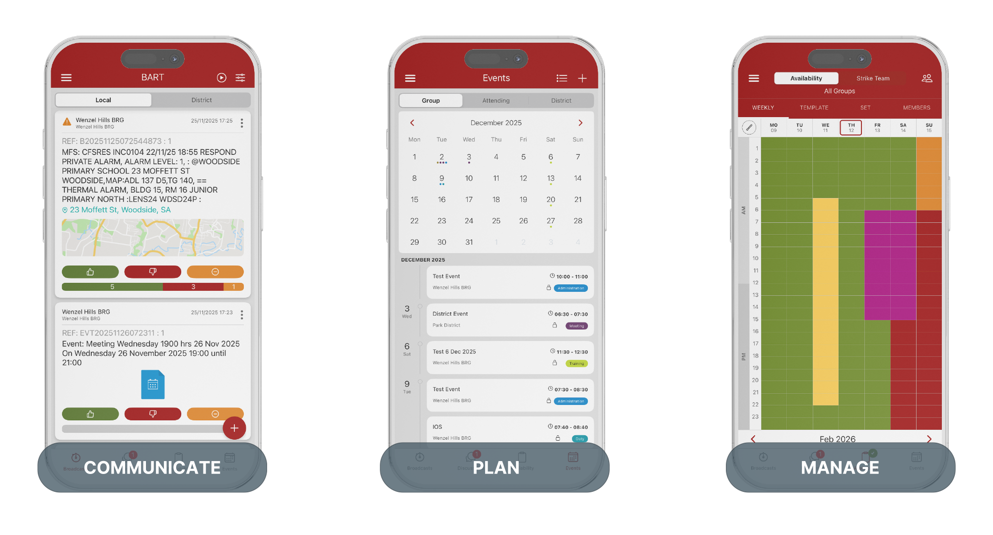
Helping People,
Help People
Battle-tested, industry-leading, emergency response & management app

